Slide 1


SUN CITY FIRE DISTRICT 2026-27 OPEN ENROLLMENT

Slide 2

2026-27 Open Enrollment
Open Enrollment
April 13 through April 30, 2026
Add, change or delete current elections (including changing plans, adding or dropping dependents, etc.)
Annual election unless Qualified Family Status change during plan year
Changes to eligibility must be made within 31 days of the event; if not, must wait until the next annual open enrollment period
Benefits Effective July 01, 2026

Slide 3

2026-27 Benefit Changes
Medical
Increase In-Network HDHP Deductible and Maximum Out-of-Pocket from $3,300/$6,600 to $3,400/$6,800
Add BlueCard Program through BlueCross BlueShield of AZ
Adds National Access to In-Network Care through BlueCross BlueShield Providers
Changes Telemedicine from Teladoc to AZBlue Telehealth
WILL REQUIRE NEW ID CARDS FOR ALL MEMBERS
Add Leap Health Infusion Program
Ability to move infusion care from hospital to in-home
Lower cost medications
Add Maternal Health Program
Prescription
New Pharmacy Benefit Manager (PBM) – SmithRx
Requires Member Engagement!
Supplemental Life Insurance
One-Time OE Opportunity
Notes:
PPIs: Available OTC – Nexium, Prilosec, Etc.
Nasal: Available OTC -

Slide 4
Quick Plan Review
SCFMD offers 4 Medical/Rx plans for you to choose from!
High Deductible Health Plan (HDHP)
$3,400/$6,800 Deductible/Max Out-of-Pocket (In-Network)
Includes Prescriptions
Once Deductible Met – Eligible Expenses Paid at 100%
Preventive Care Provided With No Member Cost Share
You MUST elect the HDHP to be eligible for the Health Savings Account (HSA)

Slide 5
Quick Plan Review (continued)
Preferred Provider Option (PPO)
$750/$1,500 Deductible (In-Network)
$3,500/$7,000 Maximum Out-of-Pocket (In-Network)
Excludes Prescriptions – Separate Maximum of $3,600/$7,200
Office Visit Co-Pays
$25 Primary Care Providers
$45 Specialist
Coinsurance
20%
Preventive Care Provided With No Member Cost Share

Slide 6
Quick Plan Review (continued)
Preferred Provider Option Buy-Up (PPO Buy-Up)
$250/$500 Deductible (In-Network)
$3,000/$6,000 Maximum Out-of-Pocket (In-Network)
Excludes Prescriptions – Separate Maximum of $4,100/$8,200
Office Visit Co-Pays
$25 Primary Care Providers
$45 Specialist
Coinsurance
20%
Preventive Care Provided With No Member Cost Share

Slide 7
Quick Plan Review (continued)
Exclusive Provider Plan (EPO)
$300/$600 Deductible (In-Network)
$2,750/$5,500 Maximum Out-of-Pocket (In-Network)
Excludes Prescriptions – Separate Maximum of $4,100/$8,200
Office Visit Co-Pays
$20 Primary Care Providers
$40 Specialist
Coinsurance
10%
Preventive Care Provided With No Member Cost Share

Slide 8

Flexible Spending Accounts (FSA)
Available to Members Enrolled in PPO or EPO Plans
Set aside $ on a pre-tax basis for eligible healthcare or dependent care expenses
USE IT OR LOSE IT!*
Must re-enroll every year
Maximum Contribution
$3,400 Maximum Contribution – Healthcare
$7,500 Maximum Contribution – Dependent Care ($3,750 Single Filer)

Slide 9
Health Savings Account (HSA)
Only available with enrollment in the HDHP
Maximum Contributions
2025 = $4,400 / $8,750 ($1,000 Catch-Up 55+)
Funds Roll Over Year-to-Year (No Use / Lose)
Sun City Fire District Contributes $ To Your HSA!
$150/Mo. for Employee Only Coverage
$250/Mo. for Dependent Coverage

Slide 10
2026-27 Monthly Medical/Rx Premiums
 | 2025-26 Premium | 2026-27 Premium | Difference | Employee Cost | Difference
HDHP
Employee Only | $603.22 | $660.54 | $57.32 | $0.00 | $0.00
Employee+Spouse | $1,186.56 | $1,299.31 | $112.75 | $127.75 | $11.08
Employee+Child(ren) | $1,091.69 | $1,195.43 | $103.74 | $106.98 | $9.29
Employee+Family | $1,613.33 | $1,766.64 | $153.31 | $221.22 | $19.02
EPO
Employee Only | $689.53 | $755.05 | $69.52 | $94.51 | $8.20
Employee+Spouse | $1,380.83 | $1,512.04 | $131.21 | $340.48 | $29.54
Employee+Child(ren) | $1,270.34 | $1,391.06 | $120.72 | $302.61 | $26.27
Employee+Family | $1,878.00 | $2,056.46 | $178.46 | $511.04 | $44.35

Slide 11
2026-27 Monthly Medical/Rx Premiums (continued)
 | 2025-26 Premium | 2026-27 Premium | Difference | Employee Cost | Difference
PPO
Employee Only | $658.26 | $720.81 | $62.55 | $60.27 | $5.23
Employee+Spouse | $1,314.77 | $1,439.71 | $124.94 | $268.15 | $23.27
Employee+Child(ren) | $1,210.53 | $1,325.56 | $115.03 | $237.11 | $20.58
Employee+Family | $1,783.62 | $1,953.11 | $169.49 | $407.69 | $35.38
PPO Buy-Up
Employee Only | $673.72 | $736.97 | $63.25 | $76.43 | $6.63
Employee+Spouse | $1,343.21 | $1,470.85 | $127.64 | $299.29 | $25.97
Employee+Child(ren) | $1,238.74 | $1,356.45 | $117.71 | $268.00 | $23.28
Employee+Family | $1,828.16 | $2,001.88 | $173.72 | $456.46 | $39.61

Slide 12
Leap Health Infusion Program
Makes infusion care simpler, more affordable and easier to manage
Changes site of care from hospital to home (or other) settings
Less expensive
More comfortable
Lower cost medications

Slide 13

Infusion therapies are breakthrough treatments for a wide range of chronic and acute conditions
Specialty Infusions commonly used to treat:
Rheumatoid arthritis (Prolia, Orencia)
Oncology (Keytruda, Mvasi)
Osteoarthritis and osteoporosis (Reclast, Actemra)
Crohn’s disease (Remicade, Entyvio, Avsola)
Lupus (Benlysta, Rituxan)
Ulcerative colitis (Stelara, Remicade, Entyvio)
Psoriasis (Infliximab, Skyrizi)
MS (Ocrevus)
More…

Slide 14




Introducing Leap
A transparent infusion benefit delivering measurable savings while creating a seamless member experience
What Leap Does
What This Means for Your Members
What This Means for You
Proactively identifies eligible members through medical claims and prior authorization files
Coordinates infusion care end to end
Integrates directly within the medical benefit and existing carrier workflow. Works fully within the medical benefit
Dedicated Care Guide support from referral through follow up
Infusion at home when clinically appropriate, reducing unnecessary travel
Clear communication and coordinated scheduling
A seamless member experience employees value
Meaningful medical savings without benefit redesign
Coordinated clinical integration with minimal administrative lift during and after implementation
Hard dollar medical savings with a simple, coordinated member experience

Slide 15

Member Experience Overview
Outreach and Onboarding
Proactive patient outreach and education to set expectations early
1
Ongoing Care Coordination
Benefits and Authorization
5
2
Follow up, provider communication, and escalation as needed
Prior authorization and benefits verification handled before care begins
Care Guide
4
3
Nursing Coordination
Pharmacy Coordination
Consistent, skilled nursing aligned to patient needs and schedule
Medication sourcing, shipping, and issue resolution managed end to end

Slide 16






Leap optimizes the patient experience
Jack (patient) learns that he will need recurring Ocrevus infusions. His health benefit offers Leap as the preferred infusion provider.
Phases
Identification
Care Coordination
Savings
Scheduling
Treatment
Continuity of Care
Proactive outreach
Leap identifies Jack as eligible through claims and prior authorization files, and reaches out by email and phone. Jack speaks with a Leap Care Guide and consents to care coordination.
Seamless coordination
Jack’s Care Guide coordinates with his provider to obtain his prescription, verifies his benefits eligibility, manages prior authorizations, and works with his pharmacy on medication fulfillment.
No out-of-pocket expenses
Jack’s at-home infusions have passed prior authorization and his copay has been waived. His Leap benefit will be provided at no cost to him.
Scheduling around patient availability
Jack’s Care Guide schedules his infusion at a time that works best for him (including evenings and weekends). Medications are delivered promptly to his home.
Convenient care at home or in nearby clinic
Jack’s infusion treatment with his licensed infusion nurse only takes 2 hours, in the comfort of his own home. His nurse schedules his next treatment on the spot.
Post-care coordination
Jack’s Care Guide follows up on his experience and shares his nurse’s visit notes with his prescribing provider.

Slide 17
BlueCard Program
Provides access to national BlueCard PPO network
AmeriBen continues to process claims
Includes telehealth (AZBlue Telehealth)
General Medical
Counseling
Psychiatry
New ID cards required

Slide 18

Understanding your health plan
The four key elements to your health plan:
Third party administrator – AmeriBen
AmeriBen handles and processes your health insurance claims. After reviewing services, claims are sent to AmeriBen for processing and payment, based on the plan language
Utilization management – AmeriBen Medical Management
Some health services require precertification. Utilization management reviews if services will be covered but doesn’t guarantee benefits or eligibility. Failure to pre-certify may lead to covering the full cost of care.
Preferred network – BlueCross BlueShield of Arizona
Choose in-network providers to minimize costs. Out-of-network care costs more. Using network providers reduces expenses for both you and your employer.
Pharmacy benefit manager (PBM) – SmithRx
For prescription coverage, pharmacy benefit manager (PBM) provider provides lower fees for medications. Contact PBM Provider using information on your ID card.

Slide 19
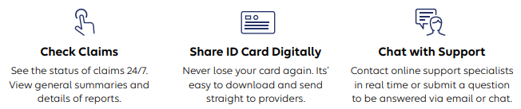
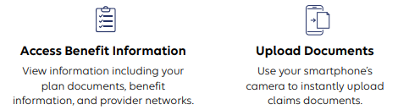
MyAmeriBen.com – Member Portal

Slide 20
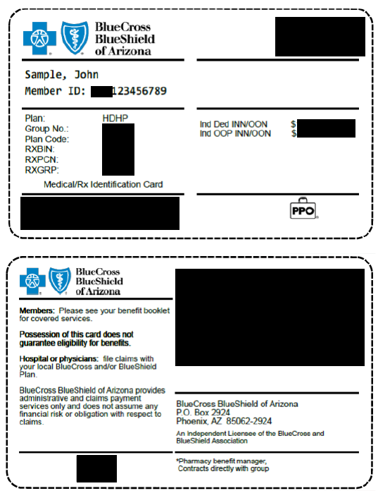
Nationwide & around the world- you’re covered with AZ Blue
What is changing?
National provider access- members will no longer be limited to Arizona providers..
New ID cards (example)
AmeriBen will continue to handle member inquiries.
New provider search link: www.azblue.com/jaanetwork2
Access to BlueCross BlueShield of Arizona telemedicine services Telehealth by AZ Blue

Slide 21
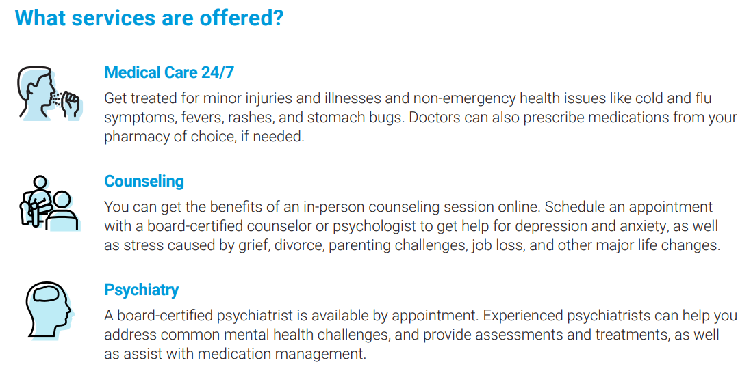
Telehealth from AZ Blue
Care is available now!
Visit AZBlueTelehealth.com to start a visit.
Customer service line: 1-844-606-1612

Slide 22
AmeriBen Maternal Health
Personalized support to assist in maintaining health and avoiding complications during and after pregnancy

Slide 23
Pharmacy Benefits Manager (PBM)
Moving to SmithRx
No change to copays, etc.
Expanded network access – CVS
Change in mail order and specialty pharmacies
AzMT will provide refill transfer files to automatically transfer open prescriptions
Different philosophy – focused on lowest net cost for both member and Trust
Member engagement is required!

Slide 24


Pharmacy Benefits Open Enrollment Info
Our mission is to reduce the cost and complexity of prescription drugs with radical transparency.
smithrx.com | 2025

Slide 25


What is a PBM and how do I get my medications?
Pharmacy Benefit Managers (PBM) coordinate the interaction between your employer, physician and pharmacy.
How does the PBM help my pharmacy experience?
Making sure youʼre charged the correct copay at the pharmacy.
Setting up your medications to be covered according to your plan design.
Managing clinical requirements related to your prescriptions.
How do I get coverage?
Youʼre automatically covered when you enroll in your health plan.

Slide 26



Will my pharmacy experience change?
For most plan members, there will be little to no change. Go to your usual pharmacy and get your medications.
Member ID Card
Remember to present your new card at the pharmacy.
Medication Coverage
You can find your formulary and benefits resources in our Member Portal.
Member Support
Our dedicated Member Support team is available via 844.454.5201
6 am - 7 pm ( M T ) Mon-Fri 9 am - 2 pm ( M T ) Mon-Fri

Slide 27
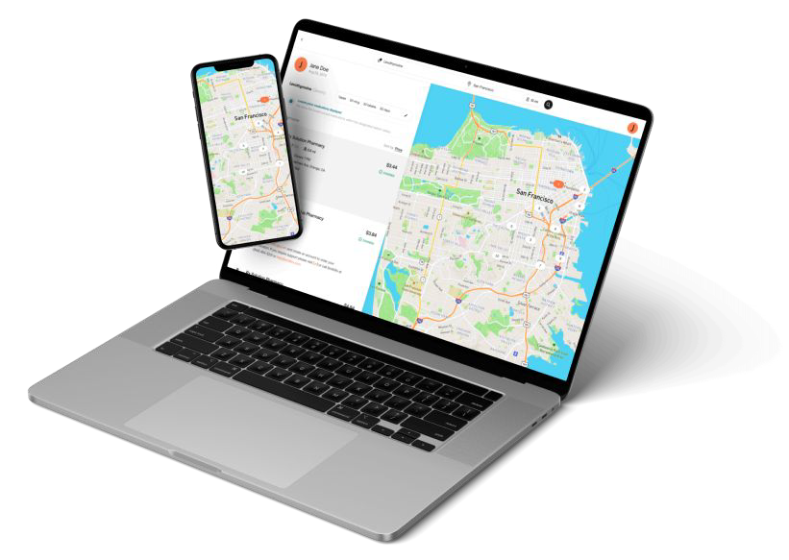

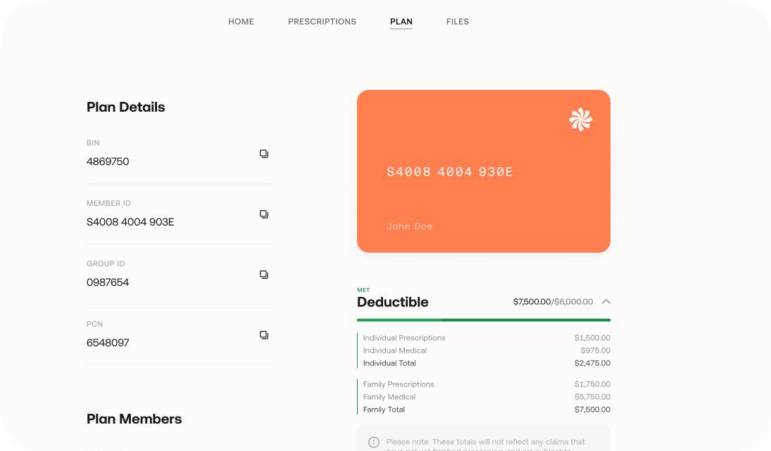

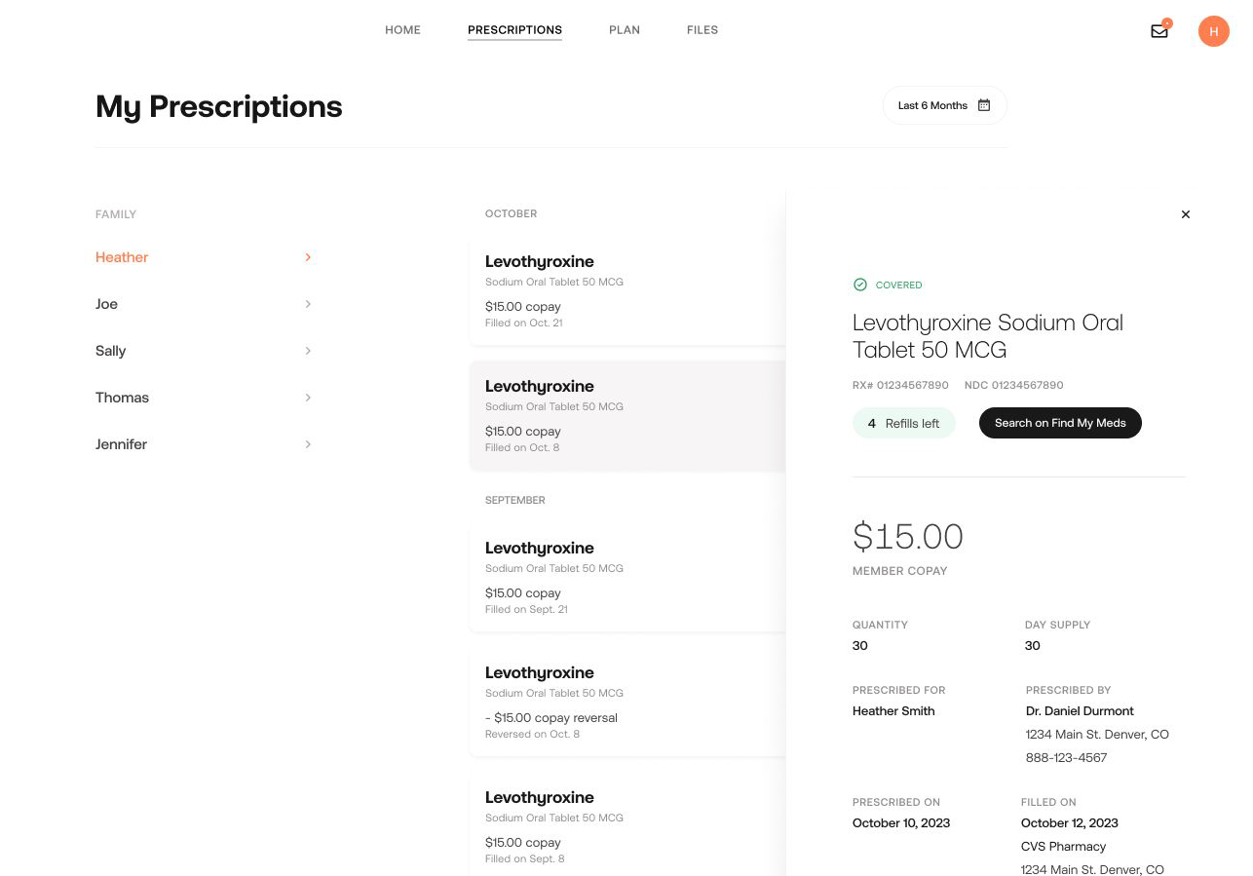
Recommended Resource: Member Portal
Discover easy Rx benefits management in the Member Portal: smithrx.com/portal
Member ID Card
View Claims, PA status
Access your Member ID Card and forms
View prescription claims. Get Prior Authorization Status Notifications
Plan Usage Tracker
Find My Meds
Track total spends against your plan deductible and out-of-pocket limits and the total spend breakdown
Search for the lowest cost pharmacy near you with the Find My Meds tool

Slide 28
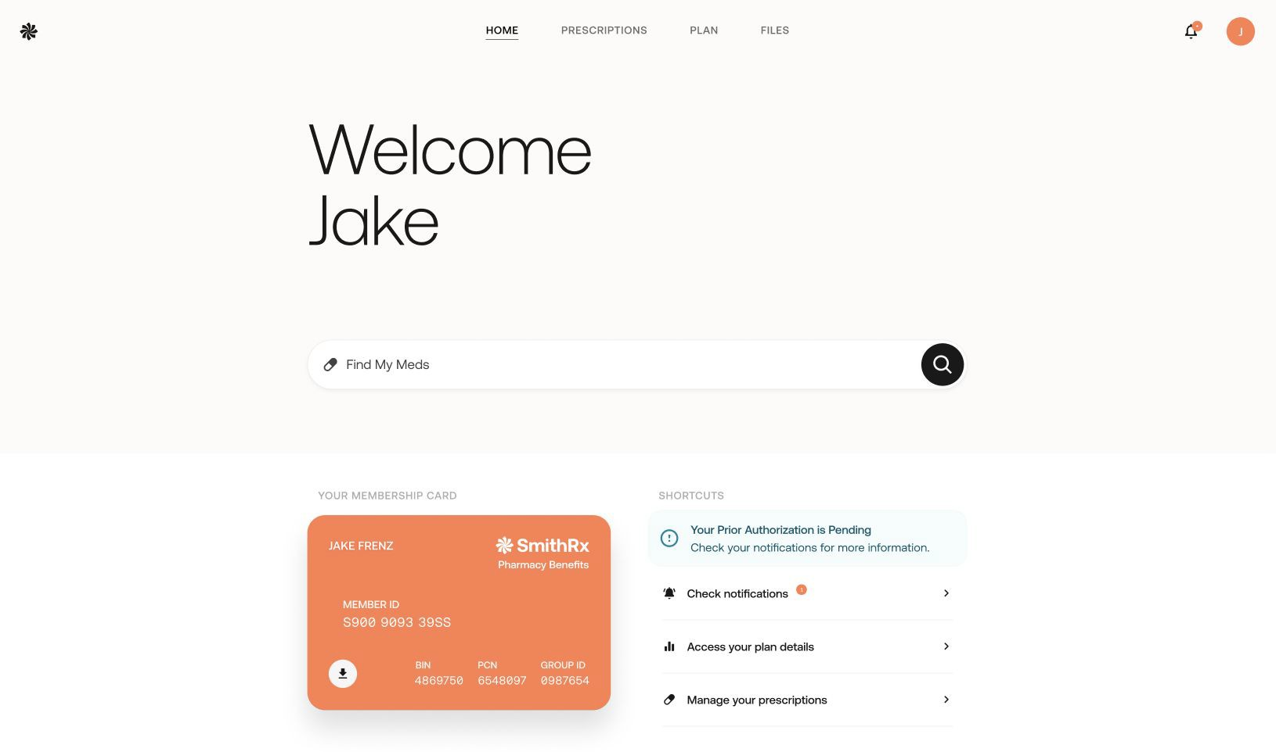
smithrx.com

Slide 29
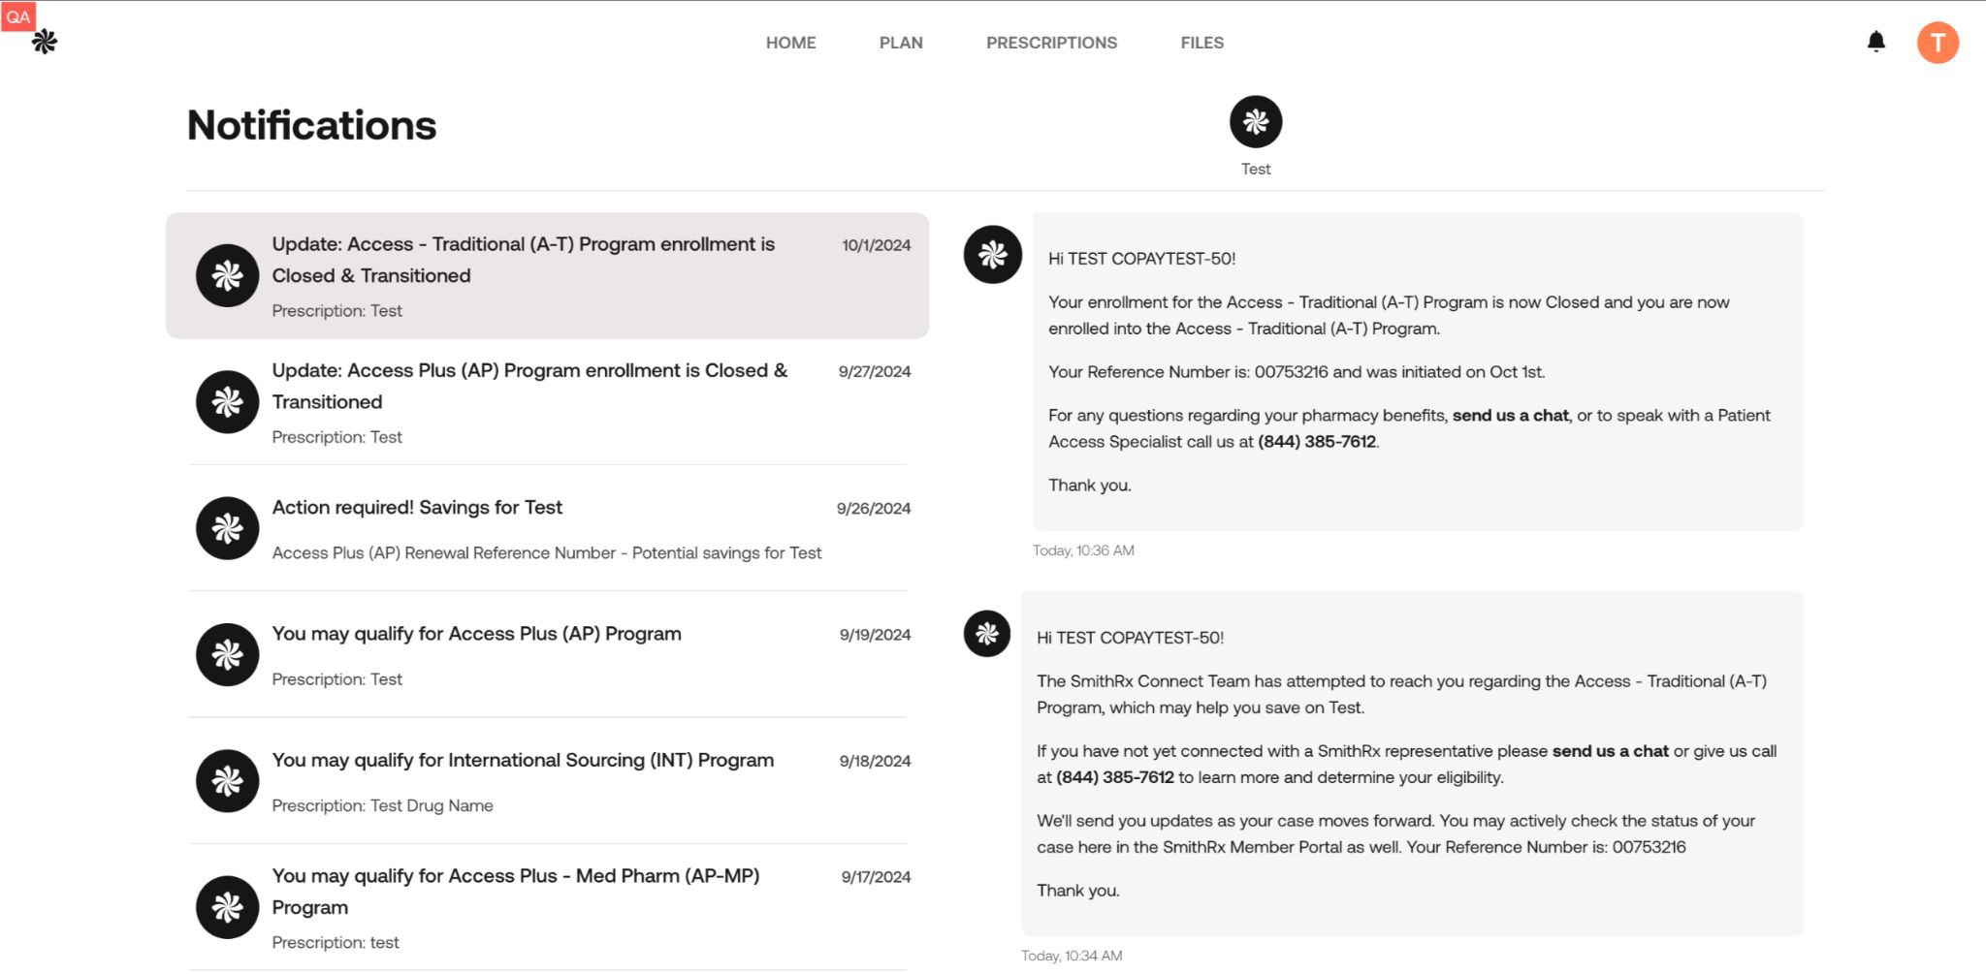
smithrx.com

Slide 30









Our Nationwide Pharmacy Network
65,000 retail locations and growing
Retail Network
Mail Network
Specialty Pharmacy

Slide 31
Connect 3 6 0 : Opportunities for more Rx savings
1
If youʼre taking a qualifying drug, you may hear from SmithRx about additional cost savings programs
2
The SmithRx representative will help you navigate the savings program enrollment
How our cost savings program works to get help you achieve $0 copay
3
Ensure your HR team has your contact information on file so we can reach you and guide you through the easy cost-savings process

Slide 32




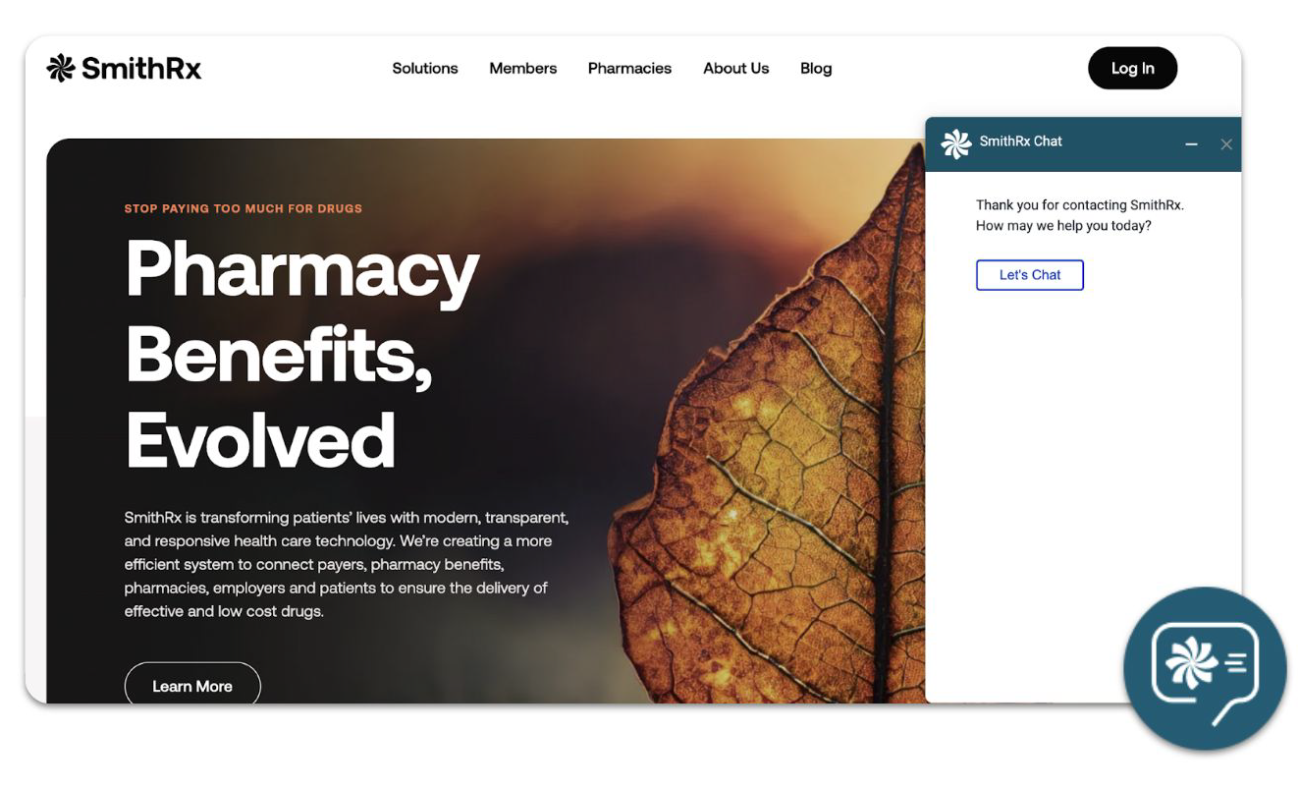

SmithRx Member Services
We make it easy and convenient for you to access your medications and Rx benefits.
Live Chat
Just click the chat icon on the bottom-right of the web page to start.
Member Portal
Create an account on our Member Portal at smithrx.com/portal.
Access answers to FAQs.
Phone
(844) 454-5201
Member Specialists are available: 6 am - 7 pm (MT) Mon - Fri
9 am - 2 pm (MT) Sat
Email
Email: help@smithrx.com

Slide 33


CONNECT 360
Cost Savings Programs Adapted to Market Needs
Access Plus Access Specialty Access Traditional | Autoimmune (Humira biosimilars) Cost Plus Drugs Low-Cost Insulin Diabetes Non-Insulin | Multiple Sclerosis GLP1 Referral Network (340) Medical Pharmacy
Pre-2023 | 2023 | 2024
New Programs Diabetes Weight Loss
Program Expansions
Autoimmune Referral Partners
2025

Slide 34
Connect 360: Opportunities for Rx Savings
What are the Connect 360 Programs?
Access (CA-S & CA-T) Capture manufacturer coupon savings on traditional and specialty medications. Members have a low or $0 copay on prescriptions while also helping employers save on pharmacy benefit costs.
Access Plus: Leverages advocacy foundations and grant programs to reduce cost when a high-cost specialty medication is not covered under the pharmacy benefit. We assist members in navigating and applying to these different programs.
Autoimmune: Through this program, SmithRx members can now access low cost, FDA-approved biosimilars such as Yusimry, a biosimilar for Humira, and Otulfi, a biosimilar for Stelara, through Cost Plus Drugs and Costco Specialty Pharmacy. FDA-approved biosimilars have no clinically meaningful differences in terms of safety and effectiveness from their brand-name counterparts, while offering a more affordable option for members with autoimmune conditions.
Low-Cost Insulin (LCI): This program helps reduce insulin costs at the pharmacy by transitioning to generic and biosimilar insulin products.
Diabetes Non-Insulin (DNI) : Through our partnership with Cost Plus Drugs, we are offering Brenzavvy, an SGLT2 inhibitor, as the lowest cost option for members with type 2 diabetes.
Cost Plus Drugs : Cost Plus Drugs is building an innovative pharmacy model that delivers medications at cost, plus a straightforward 15% markup, along with a $5 dispensing fee and shipping. Cost Plus Drugs carries over 1,000 medications and is continuing to expand their drug list weekly.
Multiple Sclerosis (MS) (at Cost Plus Drugs) The lowest-cost Multiple Sclerosis products on the market through Cost Plus Drugs. Generics offer substantial upfront savings.
Referral Partner Program (340B) Provides members with lower net costs for eligible program medications. By providing access to discounted medications, the 340B program helps eligible healthcare organizations stretch their resources further, enhance patient care, and improve health outcomes.
14

Slide 35
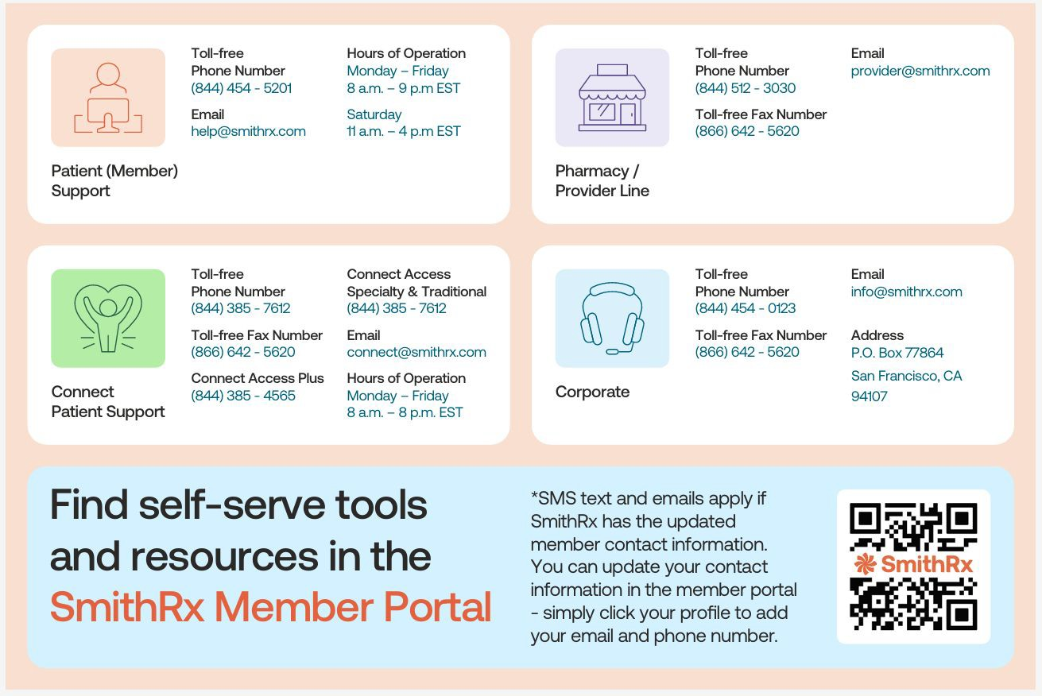
smithrx.com | 2025

Slide 36

Delta Dental of AZ

Slide 37
2026-27 Plan Changes
No Plan, Benefit or Premium Changes!
 | 2025-26 Premium | 2026-27 Premium | Difference | Employee Cost | Difference
Basic Plan (Dep Age 19)
Employee Only | $40.96 | $40.96 | $0.00 | $0.00 | $0.00
Employee+Spouse | $78.86 | $78.86 | $0.00 | $7.58 | $0.00
Employee+Child(ren) | $88.27 | $88.27 | $0.00 | $9.46 | $0.00
Employee+Family | $130.16 | $130.16 | $0.00 | $17.84 | $0.00
Buy-Up Plan (Dep Age 26)
Employee Only | $42.41 | $42.41 | $0.00 | $1.45 | $0.00
Employee+Spouse | $81.80 | $81.80 | $0.00 | $10.52 | $0.00
Employee+Child(ren) | $96.07 | $96.07 | $0.00 | $17.26 | $0.00
Employee+Family | $141.80 | $141.80 | $0.00 | $29.48 | $0.00
Please Note: If you elect the Basic Plan and you have a dependent who will reach Age 19 during the 2025-26 plan year, that is NOT considered a qualifying event and you will not be able to elect the Buy-Up Plan mid-year.

Slide 38

VSP Vision Plan

Slide 39
2026-27 Vision Plan Changes
No Plan or Benefit Changes
Slight Premium Increase
 | 2025-26 Premium | 2026-27 Premium | Difference | Employee Cost | Difference
Basic Plan (Dep Age 19)
Employee Only | $7.68 | $7.98 | $0.30 | $7.98 | $0.30
Employee+Spouse | $16.92 | $17.58 | $0.66 | $17.58 | $0.66
Employee+Child(ren) | $14.93 | $15.51 | $0.58 | $15.51 | $0.58
Employee+Family | $24.05 | $24.99 | $0.94 | $24.99 | $0.94
Buy-Up Plan (Dep Age 26)
Employee Only | $11.04 | $11.47 | $0.43 | $11.47 | $0.43
Employee+Spouse | $24.77 | $25.74 | $0.97 | $25.74 | $0.97
Employee+Child(ren) | $22.95 | $23.85 | $0.90 | $23.85 | $0.90
Employee+Family | $37.31 | $38.77 | $1.46 | $38.77 | $1.46
Please Note: If you elect the Basic Plan and you have a dependent who will reach Age 19 during the 2025-26 plan year, that is NOT considered a qualifying event and you will not be able to elect the Buy-Up Plan mid-year.

Slide 40

Employee Assistance Program (EAP)

Slide 41
SupportLinc
6 Free Visits per “Issue” per Year
Family Assist
Legal Assist
Safe Ride
Website: www.supportlinc.com
User Name – azmt

Slide 42

Life Insurance

Slide 43

2026-27 Life Insurance Changes
One-Time Open Enrollment Opportunity
$10,000 Supplemental Life with No Medical Questions
Resulting Amount of Supplemental Insurance Can’t Exceed $300,000
Update your Beneficiary
Please contact HR with questions!

Slide 44
VOLUNTARY BENEFIT

Slide 45
GALLAGHER MARKETPLACE
Access to Gallagher Marketplace
Additional Discounted Benefits
Home and Auto Insurance
Boat, RV or Renters Insurance
Pet Insurance
And more…
Enroll Anytime
Simple Enrollment Process with Payment Options
Easily Compare Rates from Multiple Carriers

Slide 46
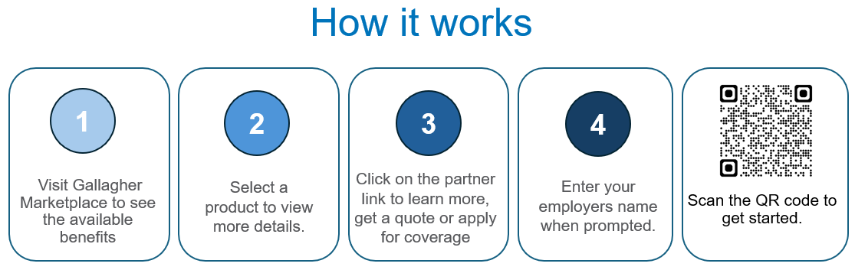
GALLAGHER MARKETPLACE
All programs are portable so you can keep the coverage no matter where life takes you
Visit Gallagher Marketplace to get started.
When prompted to enter your employer’s name, please use AzMT.

Slide 47


Wellness Program

Slide 48
AzMT L.I.V.E.
Early Detection Through Preventive Screenings
Preventive and early detection screenings are brought onsite to provide members a convenient and timely way to protect their health. Preventive screenings and services brought onsite through the AzMT Wellness Program are covered at 100% for eligible AzMT medical plan members. On-site events include, but not limited to, the following:
Health Risk Assessment
Skin Cancer Screenings
Cardiac and Organ Screenings
Mammograms
* Preventive screenings and services are subject to change. Watch for emails and flyers with more details.

Slide 49
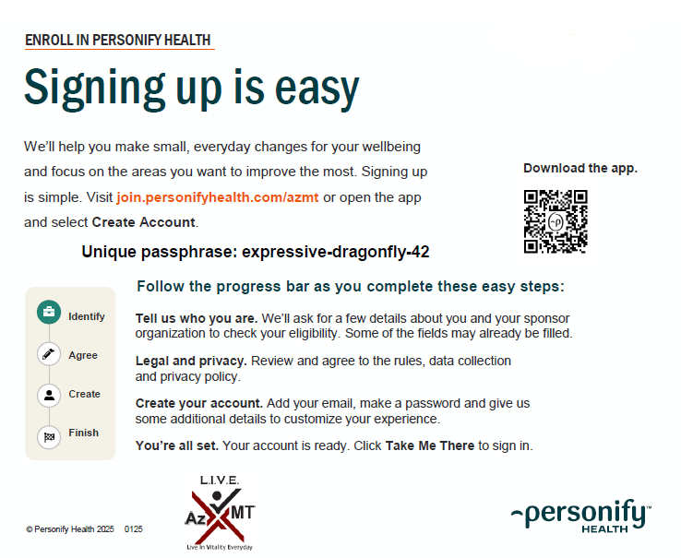
Personify Health
Personify Health
Personify Health is a wellness portal designed to help you track your healthy habits, create new ones, learn about health topics that are important to you, and much more! By engaging in the portal, you earn points that can be redeemed for big rewards.
Health Coaching
Healthy Habit Tracking
Daily Cards
Health Guides
Health Journeys
Personal challenges
Team Challenges
REWARDS!

Slide 50
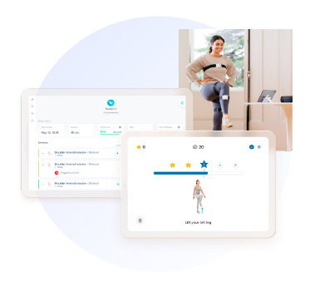
Digital Physical Therapy
Sword Health
Digital Physical Therapy
Movement is medicine. Sword uses sensor technology to deliver a physical therapy program that can be done anywhere, anytime. All the movement data is then shared with your paired physical therapist, who adapts the program based on actual performance.
Bloom
Bloom is a new, digital pelvic-therapy solution that can help women who have suffered from urinary leaking, bowel disorders, pelvic pain, and more. Bloom can be for women in all stages of life including pregnancy, postpartum and menopause.

Slide 51
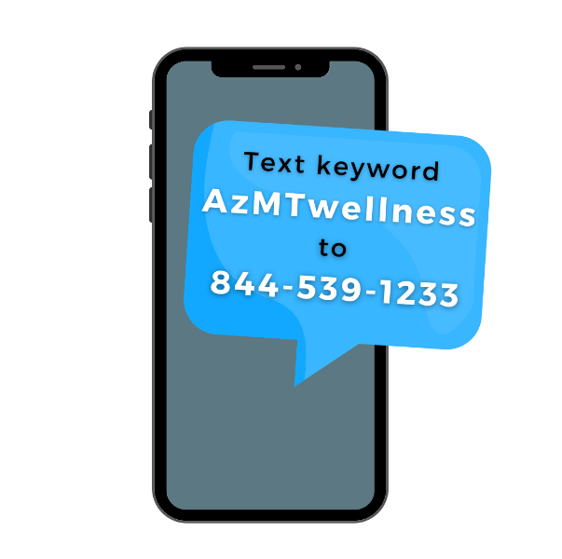

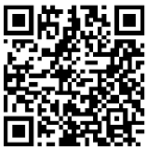
Stay Informed
Monthly Wellness Newsletter
Each month AzMT offers a free digital wellness newsletter that includes health information and upcoming events in the L.I.V.E. wellness program.
Opt-in to the newsletter by scanning the QR code.
Members can sign up with the email of their choice.
Text Message Notifications
Text messages are sent out as reminders for upcoming on-site screenings and services. Text AzMTwellness to 844-539-1233 to opt in!

Slide 52
What’s Next
No New Enrollment Forms UNLESS…
You wish to make changes to current elections
You must re-enroll for Flexible Spending annually!
Summary Plan Documents Will Be Mailed
New ID Cards
ENROLLMENT FORMS ARE DUE TO ADMINISTRATION BY 5:00PM ON APRIL 30, 2026

Slide 53

Questions?
Check with Administration OR
Jaime Schulenberg, AzMT’s Pool Administrator, at Jaime_Schulenberg@ajg.com or 928.391.2297 OR
Any of the Plan vendors!

