Slide 1


FOUNTAIN HILLS
2026-27 OPEN ENROLLMENT

Slide 2

2026-27 Open Enrollment
Benefits Effective July 01, 2026
Open Enrollment
  April 16, 2026 through May 04, 2026
  Add, change or delete current elections (including changing plans, adding or dropping dependents, etc.)
  Annual election unless Qualified Family Status change during plan year
    Changes to eligibility must be made within 31 days of the event; if not, must wait until the next annual open enrollment period

Slide 3

2026-27 Benefit Changes
Medical
  Increase In-Network HDHP Deductible and Maximum Out-of-Pocket from $3,300/$6,600 to $3,400/$6,800
  Add BlueCard Program through BlueCross BlueShield of AZ
    Adds National Access to In-Network Care through BlueCross BlueShield Providers
    Changes Telemedicine from Teladoc to AZBlue Telehealth
    WILL REQUIRE NEW ID CARDS FOR ALL MEMBERS
  Add Leap Health Infusion Program
    Ability to move infusion care from hospital to in-home
    Lower cost medications
  Add Maternal Health Program
Prescription
  New Pharmacy Benefit Manager (PBM) – SmithRx
  Requires Member Engagement!
Supplemental Life Insurance
  One-Time OE Opportunity
Notes:
PPIs: Available OTC – Nexium, Prilosec, Etc.
Nasal: Available OTC -

Slide 4
Quick Plan Review
Town of Fountain Hills offers 3 Medical/Rx plans for you to choose from!
High Deductible Health Plan (HDHP)
  $3,400/$6,800 Deductible/Max Out-of-Pocket (In-Network)
    Includes Prescriptions
  Once Deductible Met – Eligible Expenses Paid at 100%
  Preventive Care Provided With No Member Cost Share
  You MUST elect the HDHP to be eligible for the Health Savings Account (HSA)

Slide 5
Quick Plan Review (continued)
Preferred Provider Option (PPO)
  $750/$1,500 Deductible (In-Network)
  $3,500/$7,000 Maximum Out-of-Pocket (In-Network)
    Excludes Prescriptions – Separate Maximum of $3,600/$7,200
  Office Visit Co-Pays
    $25 Primary Care Providers
    $45 Specialist
  Coinsurance
    20%
  Preventive Care Provided With No Member Cost Share

Slide 6
Quick Plan Review (continued)
Preferred Provider Option Buy-Up (PPO Buy-Up)
  $250/$500 Deductible (In-Network)
  $3,000/$6,000 Maximum Out-of-Pocket (In-Network)
    Excludes Prescriptions – Separate Maximum of $4,100/$8,200
  Office Visit Co-Pays
    $25 Primary Care Providers
    $45 Specialist
  Coinsurance
    20%
  Preventive Care Provided With No Member Cost Share

Slide 7
Quick Plan Review (continued)
PPO and PPO Buy-Up Prescription Co-Pays
 | PPO & PPO Buy-Up | PPO & PPO Buy-Up
 | Network Benefit | Out-of-Network Benefit
Plan Year Out-of-Pocket Maximum
Single | $3,600 / $4,100 | $3,600 / $4,100
Family | $7,200 / $8,200
Retail Pharmacy: 30-Day Supply
Generic Drug (Tier 1) | $15 Copay | Member pays the network pharmacy copay plus the difference between the non-network and network pharmacy amount.
Preferred Drug (Tier 2) | $35 Copay
Non-Preferred Drug (Tier 3) | $55 Copay
Specialty | 20% to Max of $300 | N/A
Retail Pharmacy: 90-Day Supply
Generic Drug (Tier 1) | $30 Copay | Member pays the network pharmacy copay plus the difference between the non-network and network pharmacy amount.
Preferred Drug (Tier 2) | $80 Copay
Non-Preferred Drug (Tier 3) | $130 Copay
Mail Order Pharmacy: 90-Day Supply
Generic Drug (Tier 1) | $30 Copay | N/A
Preferred Drug (Tier 2) | $80 Copay | N/A
Non-Preferred Drug (Tier 3) | $130 Copay | N/A

Slide 8

Flexible Spending Accounts (FSA)
MUST RE-ENROLL EVERY YEAR!
  $3,400 Maximum Contribution – Medical FSA
  $7,500 Maximum Contribution – Dependent Care FSA ($3,750 if Filing Single)
  USE IT OR LOSE IT!

Slide 9
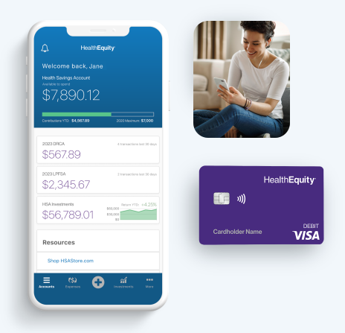
Health Savings Account (HSA)
Only available with enrollment in the HDHP
Maximum Contributions
  2026 = $4,400 / $8,750
  ($1,000 Catch-Up 55+)
Funds Roll Over Year-to-Year (No Use / Lose)

Slide 10
Leap Health Infusion Program
Makes infusion care simpler, more affordable and easier to manage
Changes site of care from hospital to home (or other) settings
  Less expensive
  More comfortable
Lower cost medications

Slide 11

Infusion therapies are breakthrough treatments for a wide range of chronic and acute conditions
Specialty Infusions commonly used to treat:
Rheumatoid arthritis
(Prolia, Orencia)
Oncology
(Keytruda, Mvasi)
Osteoarthritis and osteoporosis
(Reclast, Actemra)
Crohn’s disease
(Remicade, Entyvio, Avsola)
Lupus
(Benlysta, Rituxan)
Ulcerative colitis
(Stelara, Remicade, Entyvio)
Psoriasis
(Infliximab, Skyrizi)
MS
(Ocrevus)
More…

Slide 12




Introducing Leap
A transparent infusion benefit delivering measurable savings while creating a seamless member experience
What Leap Does
What This Means
for Your Members
What This Means
for You
Proactively identifies eligible members through medical claims and prior authorization files
Coordinates infusion care end to end
Integrates directly within the medical benefit and existing carrier workflow. Works fully within the medical benefit
Dedicated Care Guide support from referral through follow up
Infusion at home when clinically appropriate, reducing unnecessary travel
Clear communication and coordinated scheduling
A seamless member experience employees value
Meaningful medical savings without benefit redesign
Coordinated clinical integration with minimal administrative lift during and after implementation
Hard dollar medical savings with a simple, coordinated member experience

Slide 13

Member Experience
Overview
Outreach and Onboarding
Proactive patient outreach and education to set expectations early
1
Ongoing Care Coordination
Benefits and Authorization
5
2
Follow up, provider communication, and escalation as needed
Prior authorization and benefits verification handled before care begins
Care Guide
4
3
Nursing Coordination
Pharmacy Coordination
Consistent, skilled nursing aligned to patient needs and schedule
Medication sourcing, shipping, and issue resolution managed end to end

Slide 14






Leap optimizes the patient experience
Jack (patient) learns that he will need recurring Ocrevus infusions. His health benefit offers Leap as the preferred infusion provider.
Phases
Identification
Care Coordination
Savings
Scheduling
Treatment
Continuity
of Care
Proactive
outreach
Leap identifies Jack as eligible through claims and prior authorization files, and reaches out by email and phone. Jack speaks with a Leap Care Guide and consents to care coordination.
Seamless coordination
Jack’s Care Guide coordinates with his provider to obtain his prescription, verifies his benefits eligibility, manages prior authorizations, and works with his pharmacy on medication fulfillment.
No out-of-pocket expenses
Jack’s at-home infusions have passed prior authorization and his copay has been waived. His Leap benefit will be provided at no cost to him.
Scheduling around patient availability
Jack’s Care Guide schedules his infusion at a time that works best for him (including evenings and weekends). Medications are delivered promptly to his home.
Convenient care at home or in nearby clinic
Jack’s infusion treatment with his licensed infusion nurse only takes 2 hours, in the comfort of his own home. His nurse schedules his next treatment on the spot.
Post-care coordination
Jack’s Care Guide follows up on his experience and shares his nurse’s visit notes with his prescribing provider.

Slide 15
2026-27 Medical/Rx Premiums
Nominal increases in premium
  Employee premiums will need to increase for 2026-27
  Increased rates are reflected in the Open Enrollment Guide
Administration sent updated rate sheet and will review shortly

Slide 16
BlueCard Program
Provides access to national BlueCard PPO network
AmeriBen continues to process claims
Includes telehealth (AZBlue Telehealth)
  General Medical
  Counseling
  Psychiatry
New ID cards required

Slide 17

Understanding your health plan
The four key elements to your health plan:
Third party administrator – AmeriBen
  AmeriBen handles and processes your health insurance claims. After reviewing services, claims are sent to AmeriBen for processing and payment, based on the plan language
Utilization management – AmeriBen Medical Management
  Some health services require precertification. Utilization management reviews if services will be covered but doesn’t guarantee benefits or eligibility. Failure to pre-certify may lead to covering the full cost of care.
Preferred network – BlueCross BlueShield of Arizona
  Choose in-network providers to minimize costs. Out-of-network care costs more. Using network providers reduces expenses for both you and your employer.
Pharmacy benefit manager (PBM) – SmithRx
  For prescription coverage, pharmacy benefit manager (PBM) provider provides lower fees for medications. Contact PBM Provider using information on your ID card.

Slide 18
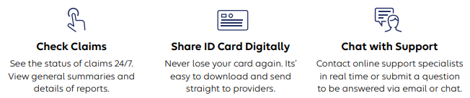
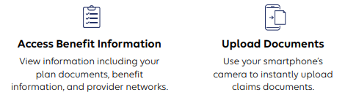
MyAmeriBen.com – Member Portal

Slide 19
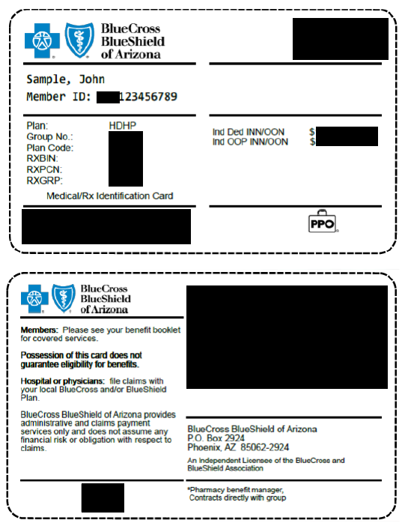
Nationwide & around the world- you’re covered with AZ Blue
What is changing?
National provider access- members will no longer be limited to Arizona providers..
New ID cards (example)
AmeriBen will continue to handle member inquiries.
New provider search link: www.azblue.com/jaanetwork2
Access to BlueCross BlueShield of Arizona telemedicine services Telehealth by AZ Blue

Slide 20
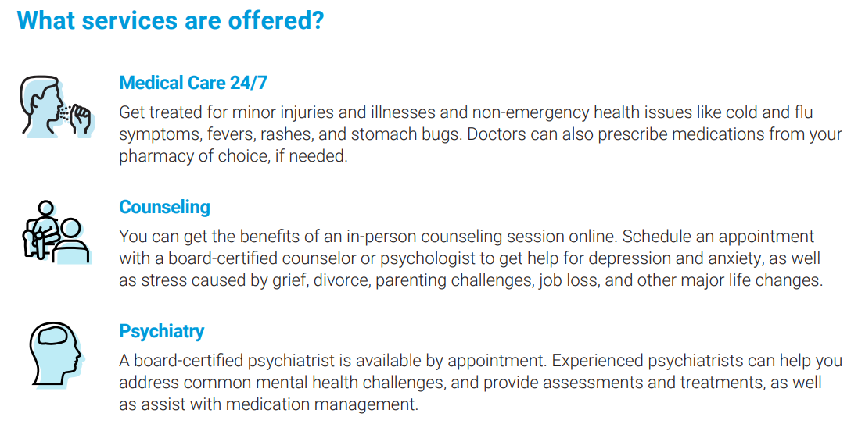
Telehealth from AZ Blue
Care is available now!
Visit AZBlueTelehealth.com to start a visit.
Customer service line: 1-844-606-1612

Slide 21
AmeriBen Maternal Health
Personalized support to assist in maintaining health and avoiding complications during and after pregnancy

Slide 22
Pharmacy Benefits Manager (PBM)
Moving to SmithRx
No change to copays, etc.
Expanded network access – CVS
Change in mail order and specialty pharmacies
  AzMT will provide refill transfer files to automatically transfer open prescriptions
Different philosophy – focused on lowest net cost for both member and Trust
Member engagement is required!

Slide 23


Pharmacy Benefits Open Enrollment Info
Our mission is to reduce the cost and complexity of prescription drugs with radical transparency.
smithrx.com | 2025

Slide 24


What is a PBM and how do I get my medications?
Pharmacy Benefit Managers (PBM) coordinate the interaction between your employer, physician and pharmacy.
How does the PBM help my pharmacy experience?
Making sure youʼre charged the correct copay at the pharmacy.
Setting up your medications to be covered according to your plan design.
Managing clinical requirements related to your prescriptions.
How do I get coverage?
Youʼre automatically covered when you enroll in your health plan.

Slide 25



Will my pharmacy experience change?
For most plan members, there will be little to no change. Go to your usual pharmacy and get your medications.
Member ID Card
Remember to present your new card at the pharmacy.
Medication Coverage
You can find your formulary and benefits resources in our Member Portal.
Member Support
Our dedicated Member Support team is available via 844.454.5201
6 am - 7 pm ( M T ) Mon-Fri 9 am - 2 pm ( M T ) Mon-Fri

Slide 26
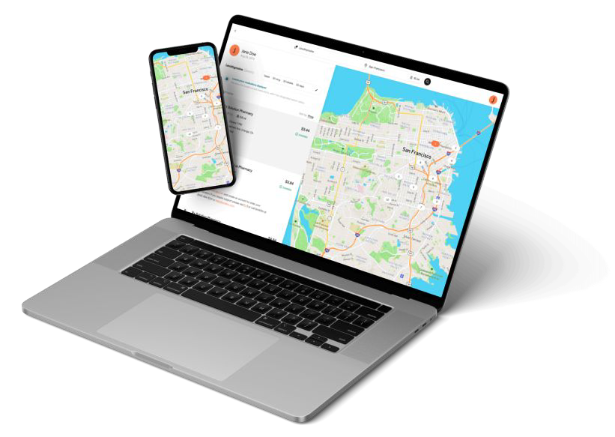

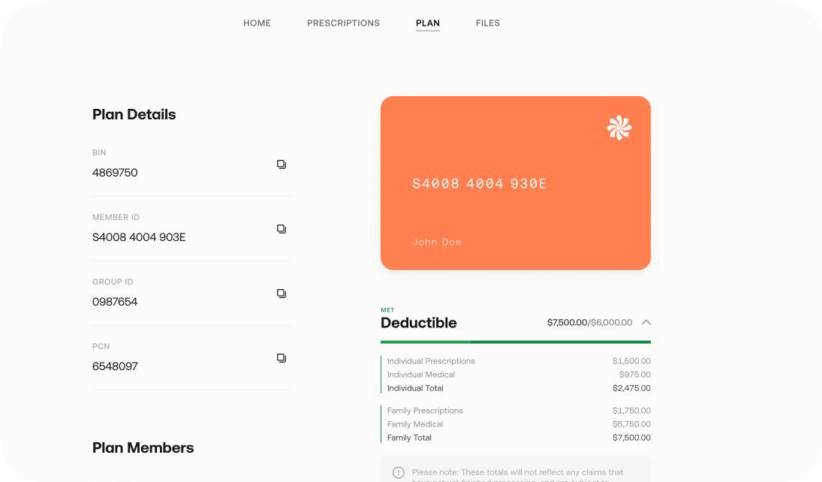

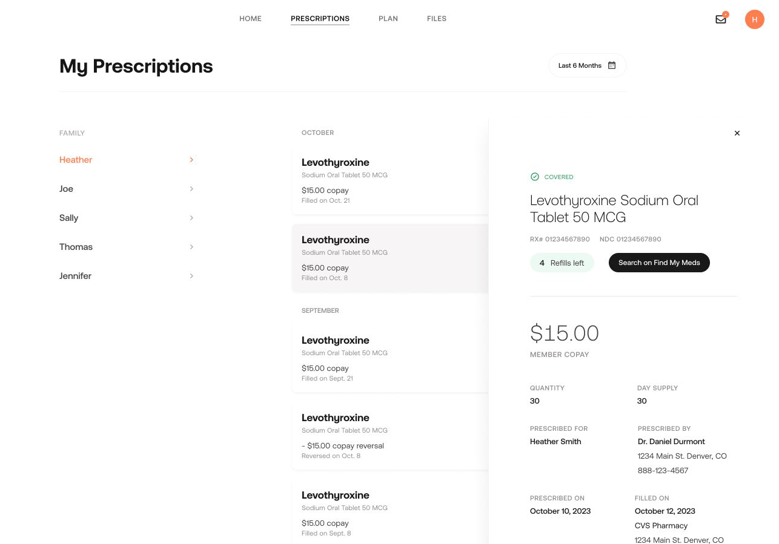
Recommended Resource: Member Portal
Discover easy Rx benefits management in the Member Portal: smithrx.com/portal
Member ID Card
View Claims, PA status
Access your Member ID Card and forms
View prescription claims. Get Prior Authorization Status Notifications
Plan Usage Tracker
Find My Meds
Track total spends against your plan deductible and out-of-pocket limits and the total spend breakdown
Search for the lowest cost pharmacy near you with the Find My Meds tool

Slide 27
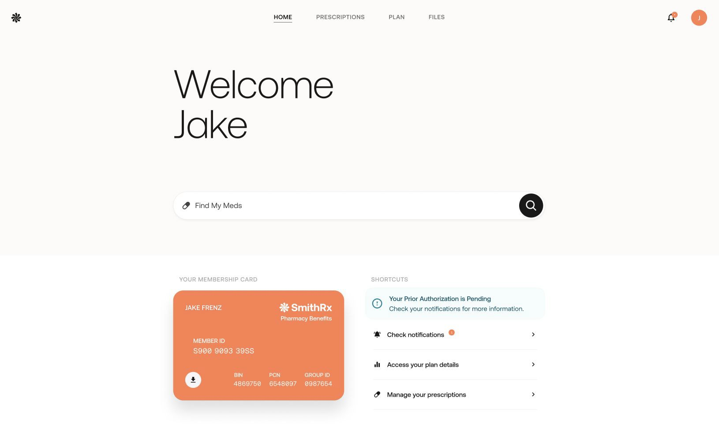
smithrx.com

Slide 28
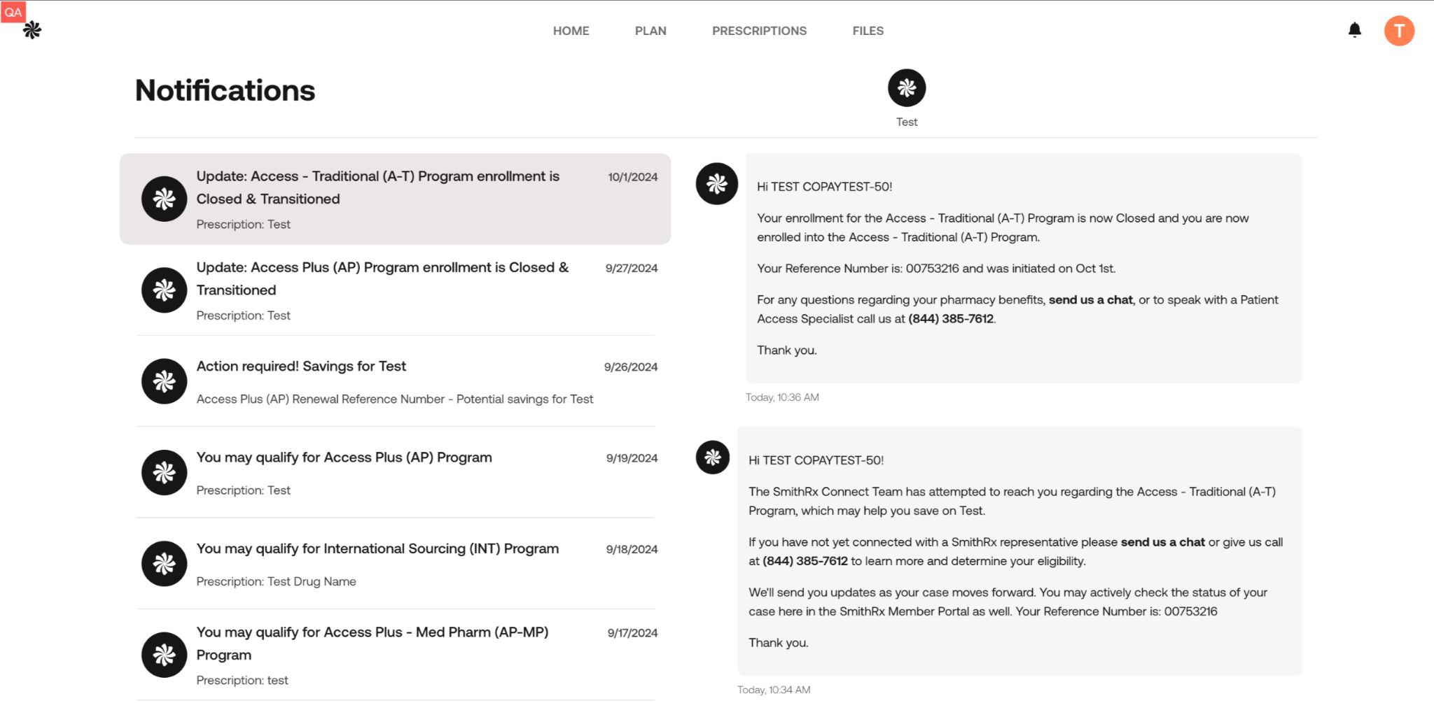
smithrx.com

Slide 29









Our Nationwide Pharmacy Network
65,000 retail locations and growing
Retail Network
Mail Network
Specialty Pharmacy

Slide 30
Connect 3 6 0 :
Opportunities for more Rx savings
1
If youʼre taking a qualifying drug, you may hear from SmithRx about additional cost savings programs
2
The SmithRx representative will help you navigate the savings program enrollment
How our cost savings program works to get help you achieve $0 copay
3
Ensure your HR team has your contact information on file so we can reach you and guide you through the easy cost-savings process

Slide 31




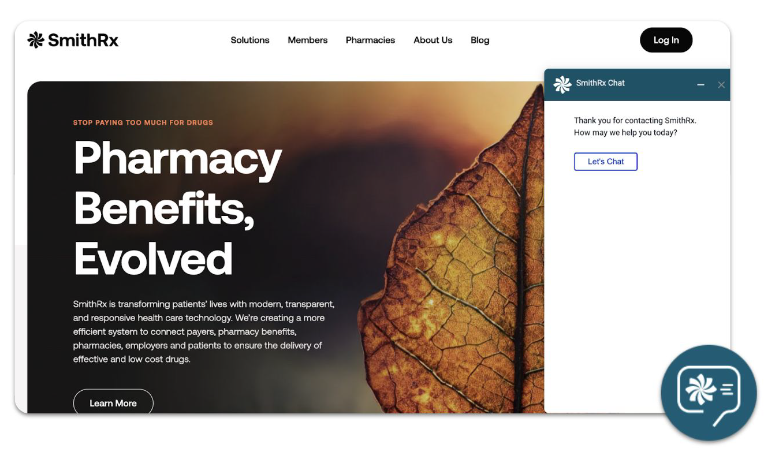

SmithRx Member Services
We make it easy and convenient for you to access your medications and Rx benefits.
Live Chat
Just click the chat icon on the bottom-right of the web page to start.
Member Portal
Create an account on our Member Portal at smithrx.com/portal.
Access answers to FAQs.
Phone
(844) 454-5201
Member Specialists are available: 6 am - 7 pm (MT) Mon - Fri
9 am - 2 pm (MT) Sat
Email
Email: help@smithrx.com

Slide 32


CONNECT 360
Cost Savings Programs Adapted to Market Needs
Access Plus Access Specialty Access Traditional | Autoimmune (Humira biosimilars) Cost Plus Drugs Low-Cost Insulin Diabetes Non-Insulin | Multiple Sclerosis GLP1 Referral Network (340) Medical Pharmacy
Pre-2023 | 2023 | 2024
New Programs Diabetes Weight Loss
Program Expansions
Autoimmune Referral Partners
2025

Slide 33
Connect 360: Opportunities for Rx Savings
What are the Connect 360 Programs?
Access (CA-S & CA-T) Capture manufacturer coupon savings on traditional and specialty medications. Members have a low or $0 copay on prescriptions while also helping employers save on pharmacy benefit costs.
Access Plus: Leverages advocacy foundations and grant programs to reduce cost when a high-cost specialty medication is not covered under the pharmacy benefit. We assist members in navigating and applying to these different programs.
Autoimmune: Through this program, SmithRx members can now access low cost, FDA-approved biosimilars such as Yusimry, a biosimilar for Humira, and Otulfi, a biosimilar for Stelara, through Cost Plus Drugs and Costco Specialty Pharmacy. FDA-approved biosimilars have no clinically meaningful differences in terms of safety and effectiveness from their brand-name counterparts, while offering a more affordable option for members with autoimmune conditions.
Low-Cost Insulin (LCI): This program helps reduce insulin costs at the pharmacy by transitioning to generic and biosimilar insulin products.
Diabetes Non-Insulin (DNI) : Through our partnership with Cost Plus Drugs, we are offering Brenzavvy, an SGLT2 inhibitor, as the lowest cost option for members with type 2 diabetes.
Cost Plus Drugs : Cost Plus Drugs is building an innovative pharmacy model that delivers medications at cost, plus a straightforward 15% markup, along with a $5 dispensing fee and shipping. Cost Plus Drugs carries over 1,000 medications and is continuing to expand their drug list weekly.
Multiple Sclerosis (MS) (at Cost Plus Drugs) The lowest-cost Multiple Sclerosis products on the market through Cost Plus Drugs. Generics offer substantial upfront savings.
Referral Partner Program (340B) Provides members with lower net costs for eligible program medications. By providing access to discounted medications, the 340B program helps eligible healthcare organizations stretch their resources further, enhance patient care, and improve health outcomes.
14

Slide 34
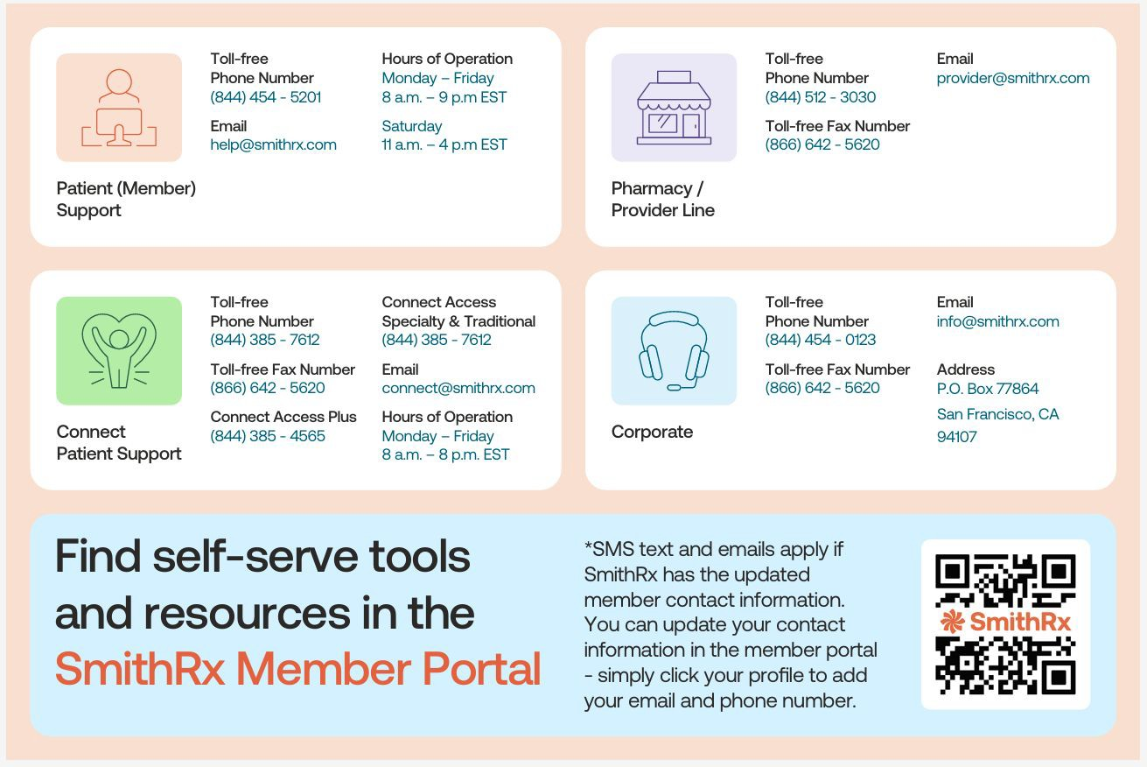
smithrx.com | 2025

Slide 35

Delta Dental of AZ

Slide 36

2026-27 Plan Changes
No Benefit or Rates Changes!
Please Note: If you elect the Basic Dental Plan and have a child who will reach Age 19 during the plan year, this is NOT a qualifying event and you will not be able to switch to the Buy-Up Plan mid-year.

Slide 37

VSP Vision Plan

Slide 38

2026-27 Vision Plan Changes
No Benefit Changes
Slight Rate Increase for 2026-27
Please Note: If you elect the Basic Vision Plan and have a child who will reach Age 19 during the plan year, this is NOT a qualifying event and you will not be able to switch to the Buy-Up Plan mid-year.

Slide 39

Employee Assistance Program (EAP)

Slide 40
SupportLinc
6 Free Visits per “Issue” per Year
Family Assist
Legal Assist
Safe Ride
Website: www.supportlinc.com
  User Name – azmt

Slide 41

Life Insurance

Slide 42

2026-27 Life Insurance Changes
One-Time Open Enrollment Opportunity
  $10,000 Supplemental Life with No Medical Questions
  Resulting Amount of Supplemental Insurance Can’t Exceed $300,000
Update your Beneficiary
If you would like to apply for Supplemental Life or make any changes to your coverage, please see Administration for the paperwork!

Slide 43

Disability Benefits

Slide 44
Short-Term Disability (STD)
Paycheck protection for short-term illness or injury that requires time off
Employer paid – Coverage through Mutual of Omaha
30-Day Elimination Period
Provides 60% of Salary up to $2,500/Week up to 13 Weeks

Slide 45
Long-Term Disability (LTD)
Paycheck protection for leave during an illness/injury
Employer Paid – Coverage through Mutual of Omaha
90-Day Elimination Period
Full & Partial Disability
Provides 60% of Salary up to $6,000/mo.

Slide 46

Wellness

Slide 47
AzMT L.I.V.E.
Early Detection Through Preventive Screenings
Preventive and early detection screenings are brought onsite to provide members a convenient and timely way to protect their health. Preventive screenings and services brought onsite through the AzMT Wellness Program are covered at 100% for eligible AzMT medical plan members. On-site events include, but not limited to, the following:
Health Risk Assessment
Skin Cancer Screenings
Cardiac and Organ Screenings
Mammograms
* Preventive screenings and services are subject to change. Watch for emails and flyers with more details.

Slide 48
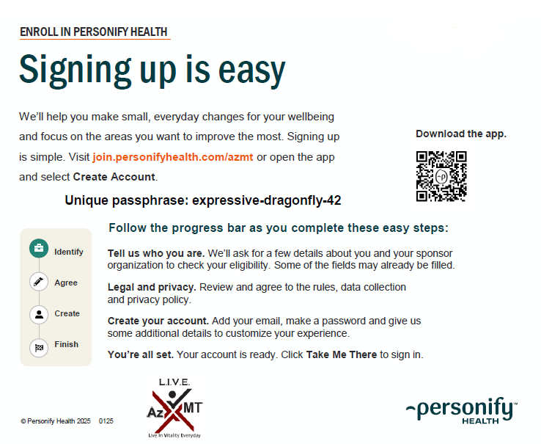
Personify Health
Personify Health
Personify Health is a wellness portal designed to help you track your healthy habits, create new ones, learn about health topics that are important to you, and much more! By engaging in the portal, you earn points that can be redeemed for big rewards.
Health Coaching
Healthy Habit Tracking
Daily Cards
Health Guides
Health Journeys
Personal challenges
Team Challenges
REWARDS!

Slide 49
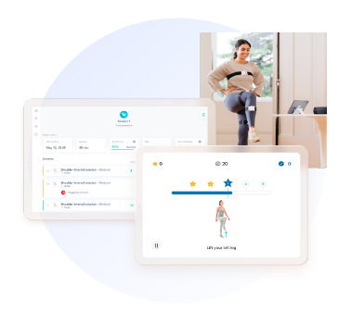
Digital Physical Therapy
Sword Health
Digital Physical Therapy
Movement is medicine. Sword uses sensor technology to deliver a physical therapy program that can be done anywhere, anytime. All the movement data is then shared with your paired physical therapist, who adapts the program based on actual performance.
Bloom
Bloom is a new, digital pelvic-therapy solution that can help women who have suffered from urinary leaking, bowel disorders, pelvic pain, and more. Bloom can be for women in all stages of life including pregnancy, postpartum, menopause and postmenopause.

Slide 50
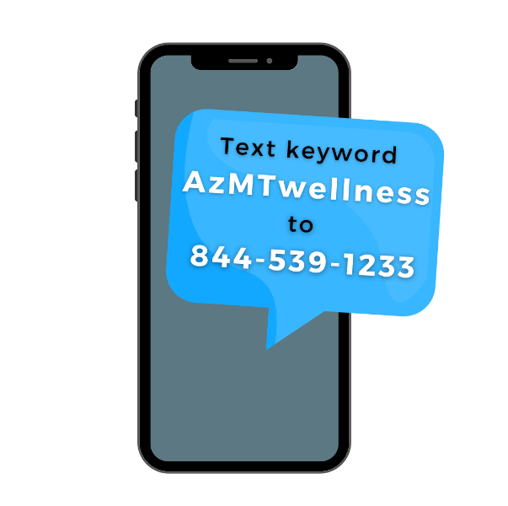

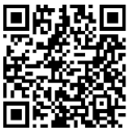
Stay Informed
Monthly Wellness Newsletter
Each month AzMT offers a free digital wellness newsletter that includes health information and upcoming events in the L.I.V.E. wellness program.
Opt-in to the newsletter by scanning the QR code.
Members can sign up with the email of their choice.
Text Message Notifications
Text messages are sent out as reminders for upcoming on-site screenings and services. Text AzMTwellness to 844-539-1233 to opt in!

Slide 51
GALLAGHER MARKETPLACE
Discounted Benefits
  Home and Auto Insurance
  Boat, RV or Renters Insurance
  Pet Insurance
  And more…
Enroll Anytime
Simple Enrollment Process with Payment Options
Easily Compare Rates from Multiple Carriers

Slide 52
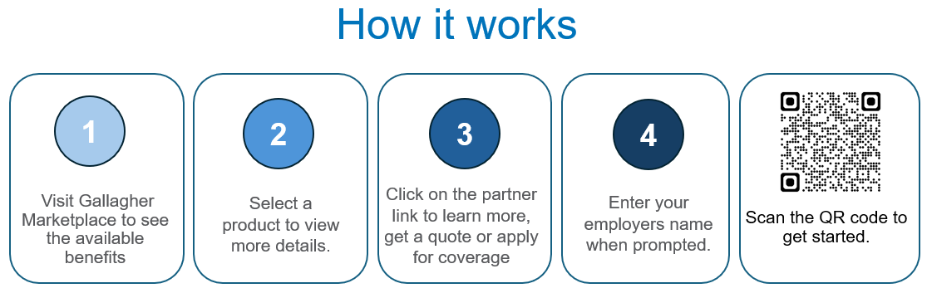
GALLAGHER MARKETPLACE
All programs are portable so you can keep the coverage no matter where life takes you
Visit Gallagher Marketplace to get started.
When prompted to enter your employer’s name, please use AzMT.

Slide 53
What’s Next
No Action Required UNLESS…
  You wish to make changes to current elections
  You wish to enroll in the FSA
    IF YOU HAVE AN EXISTING FSA AND WANT TO CONTINUE, YOU ARE REQUIRED TO RE-ENROLL ONLINE!
Summary Plan Documents (SPDs) will be mailed
New ID Cards for All Members
ALL CHANGES NEED TO BE COMPLETED THROUGH PAYCHEXFLEX.COM BY 6:00PM ON MAY 04, 2025

Slide 54

Questions?

