Slide 1


CITY OF APACHE JUNCTION 2026-27 OPEN ENROLLMENT

Slide 2

2026-27 Open Enrollment
Benefits Effective July 01, 2026
Open Enrollment
April 20th through 5:00pm on April 30th
Add, change or delete current elections (including changing plans, adding or dropping dependents, etc.)
Annual election unless qualifying life event occurs during plan year
Changes to eligibility must be made within 31 days of the event; if not, must wait until the next annual open enrollment period
EVERY EMPLOYEE MUST RE-ENROLL FOR BENEFITS DURING OPEN ENROLLMENT IN MUNIS EMPLOYEE SELF-SERVICE (ESS)
Failure to re-enroll will result in no benefits effective July 01, 2026!

Slide 3

2026-27 Benefit Changes
Medical
Increase In-Network HDHP Deductible and Maximum Out-of-Pocket from $3,300/$6,600 to $3,400/$6,800
Add BlueCard Program through BlueCross BlueShield of AZ
Adds National Access to In-Network Care through BlueCross BlueShield Providers
Changes Telemedicine from Teladoc to AZBlue Telehealth
WILL REQUIRE NEW ID CARDS FOR ALL MEMBERS
Add Leap Health Infusion Program
Ability to move infusion care from hospital to in-home
Lower cost medications
Add Maternal Health Program
Prescription
New Pharmacy Benefit Manager (PBM) – SmithRx
Requires Member Engagement!
Supplemental Life Insurance
One-Time OE Opportunity – increase of $10,000 for employees that don’t already exceed $300,000 in supplemental coverage.
Notes:
PPIs: Available OTC – Nexium, Prilosec, Etc.
Nasal: Available OTC -

Slide 4

Flexible Spending Accounts (FSA)
MUST ENROLL EVERY YEAR!
$3,400 Maximum Contribution – Medical FSA
USE IT OR LOSE IT!

Slide 5

Health Savings Account (HSA)
Only available with enrollment in the HDHP
Maximum Contributions
2026-27 = $4,400 / $8,750 ($1,000 Catch-Up 55+)
Funds Roll Over Year-to-Year (No Use It / Lose It)

Slide 6
2026-27 Medical/Rx Premiums
 | Total Monthly Premium | Monthly City Contribution | Monthly Employee Contribution
HDHP
EE - Single | $657.41 | $633.87 | $23.54
EE + Spouse | $1,299.20 | $991.79 | $307.41
EE + Child(ren) | $1,195.35 | $935.75 | $259.60
EE + Family | $1,766.57 | $1,248.57 | $518.00
PPO Base Plan
EE - Single | $720.65 | $650.22 | $70.43
EE + Spouse | $1,439.52 | $1,047.90 | $391.62
EE + Child(ren) | $1,325.47 | $985.86 | $339.61
EE + Family | $1,952.95 | $1,329.07 | $623.88
PPO Buy-Up Plan
EE - Single | $736.83 | $651.88 | $84.95
EE + Spouse | $1,473.62 | $1,059.21 | $414.41
EE + Child(ren) | $1,356.24 | $995.30 | $360.94
EE + Family | $2,001.71 | $1,346.79 | $654.92

Slide 7
Leap Health Infusion Program
Makes infusion care simpler, more affordable and easier to manage
Changes site of care from hospital to home (or other) settings
Less expensive
More comfortable
Lower cost medications

Slide 8

Infusion therapies are breakthrough treatments for a wide range of chronic and acute conditions
Specialty Infusions commonly used to treat:
Rheumatoid arthritis (Prolia, Orencia)
Oncology (Keytruda, Mvasi)
Osteoarthritis and osteoporosis (Reclast, Actemra)
Crohn’s disease (Remicade, Entyvio, Avsola)
Lupus (Benlysta, Rituxan)
Ulcerative colitis (Stelara, Remicade, Entyvio)
Psoriasis (Infliximab, Skyrizi)
MS (Ocrevus)
More…

Slide 9

Introducing Leap
A transparent infusion benefit delivering measurable savings while creating a seamless member experience
What Leap Does
What This Means for Your Members
What This Means for You
Proactively identifies eligible members through medical claims and prior authorization files
Coordinates infusion care end to end
Integrates directly within the medical benefit and existing carrier workflow. Works fully within the medical benefit
Dedicated Care Guide support from referral through follow up
Infusion at home when clinically appropriate, reducing unnecessary travel
Clear communication and coordinated scheduling
A seamless member experience employees value
Meaningful medical savings without benefit redesign
Coordinated clinical integration with minimal administrative lift during and after implementation
Hard dollar medical savings with a simple, coordinated member experience

Slide 10

Member Experience Overview
Outreach and Onboarding
Proactive patient outreach and education to set expectations early
1
Ongoing Care Coordination
Benefits and Authorization
5
2
Follow up, provider communication, and escalation as needed
Prior authorization and benefits verification handled before care begins
Care Guide
4
3
Nursing Coordination
Pharmacy Coordination
Consistent, skilled nursing aligned to patient needs and schedule
Medication sourcing, shipping, and issue resolution managed end to end

Slide 11






Leap optimizes the patient experience
Jack (patient) learns that he will need recurring Ocrevus infusions. His health benefit offers Leap as the preferred infusion provider.
Phases
Identification
Care Coordination
Savings
Scheduling
Treatment
Continuity of Care
Proactive outreach
Leap identifies Jack as eligible through claims and prior authorization files, and reaches out by email and phone. Jack speaks with a Leap Care Guide and consents to care coordination.
Seamless coordination
Jack’s Care Guide coordinates with his provider to obtain his prescription, verifies his benefits eligibility, manages prior authorizations, and works with his pharmacy on medication fulfillment.
No out-of-pocket expenses
Jack’s at-home infusions have passed prior authorization and his copay has been waived. His Leap benefit will be provided at no cost to him.
Scheduling around patient availability
Jack’s Care Guide schedules his infusion at a time that works best for him (including evenings and weekends). Medications are delivered promptly to his home.
Convenient care at home or in nearby clinic
Jack’s infusion treatment with his licensed infusion nurse only takes 2 hours, in the comfort of his own home. His nurse schedules his next treatment on the spot.
Post-care coordination
Jack’s Care Guide follows up on his experience and shares his nurse’s visit notes with his prescribing provider.

Slide 12
BlueCard Program
Provides access to national BlueCard PPO network
AmeriBen continues to process claims
Includes telehealth (AZBlue Telehealth)
General Medical
Counseling
Psychiatry
New ID cards required

Slide 13

Understanding Your Health Plan
The four key elements to your health plan:
Third party administrator – AmeriBen
AmeriBen handles and processes your health insurance claims. After reviewing services, claims are sent to AmeriBen for processing and payment, based on the plan language
Utilization management – AmeriBen Medical Management
Some health services require precertification. Utilization management reviews if services will be covered but doesn’t guarantee benefits or eligibility. Failure to pre-certify may lead to covering the full cost of care.
Preferred network – BlueCross BlueShield of Arizona
Choose in-network providers to minimize costs. Out-of-network care costs more. Using network providers reduces expenses for both you and your employer.
Pharmacy benefit manager (PBM) – SmithRx
For prescription coverage, pharmacy benefit manager (PBM) provider provides lower fees for medications. Contact PBM Provider using information on your ID card.

Slide 14
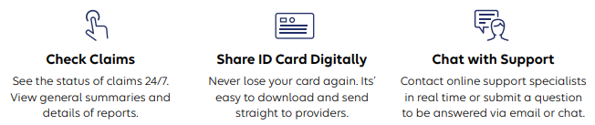
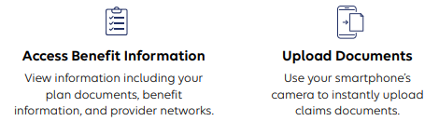
MyAmeriBen.com – Member Portal

Slide 15
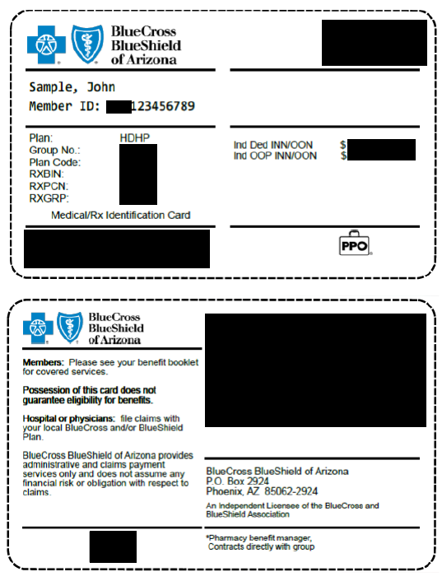
Nationwide & around the world- you’re covered with AZ Blue
What is changing?
National provider access- members will no longer be limited to Arizona providers..
New ID cards (example)
AmeriBen will continue to handle member inquiries.
New provider search link: www.azblue.com/jaanetwork2
Access to BlueCross BlueShield of Arizona telemedicine services Telehealth by AZ Blue

Slide 16
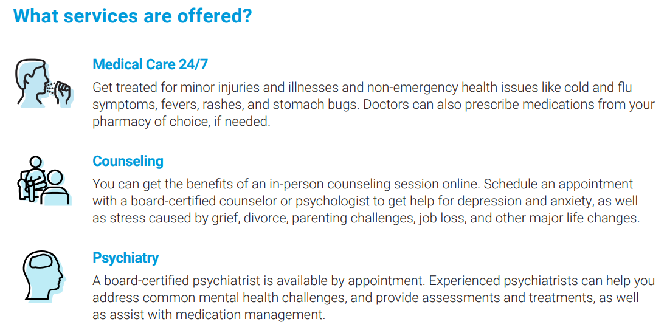
Telehealth from AZ Blue
Care is available now!
Visit AZBlueTelehealth.com to start a visit.
Customer service line: 1-844-606-1612

Slide 17
AmeriBen Maternal Health
Personalized support to assist in maintaining health and avoiding complications during and after pregnancy

Slide 18
Pharmacy Benefits Manager (PBM)
Moving to SmithRx
No change to copays, etc.
Expanded network access – CVS
Change in mail order and specialty pharmacies
AzMT will provide refill transfer files to automatically transfer open prescriptions
Different philosophy – focused on lowest net cost for both member and Trust
Member engagement is required!
https://www.smithrx.com/portal

Slide 19


Pharmacy Benefits Open Enrollment Info
Our mission is to reduce the cost and complexity of prescription drugs with radical transparency.
smithrx.com | 2026

Slide 20


What is a PBM and how do I get my medications?
Pharmacy Benefit Managers (PBM) coordinate the interaction between your employer, physician and pharmacy.
How does the PBM help my pharmacy experience?
Making sure youʼre charged the correct copay at the pharmacy.
Setting up your medications to be covered according to your plan design.
Managing clinical requirements related to your prescriptions.
How do I get coverage?
Youʼre automatically covered when you enroll in your health plan.

Slide 21



Will my pharmacy experience change?
For most plan members, there will be little to no change. Go to your usual pharmacy and get your medications.
Member ID Card
Remember to present your new card at the pharmacy.
Medication Coverage
You can find your formulary and benefits resources in our Member Portal.
Member Support
Our dedicated Member Support team is available via 844.454.5201
6 am - 7 pm ( M T ) Mon-Fri 9 am - 2 pm ( M T ) Mon-Fri

Slide 22
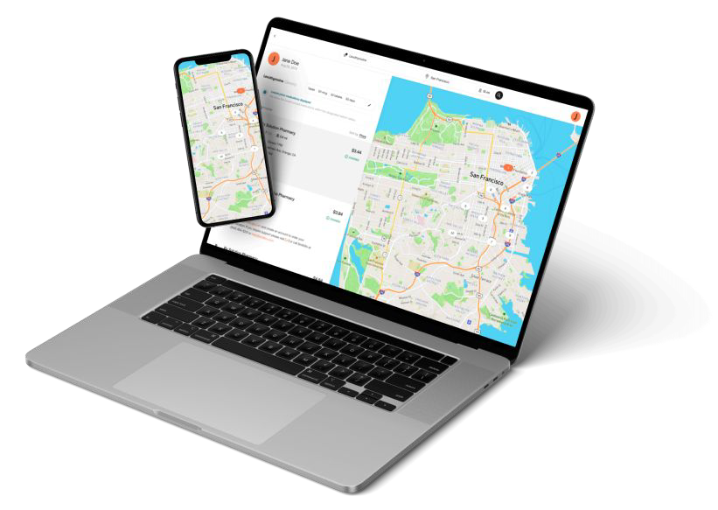

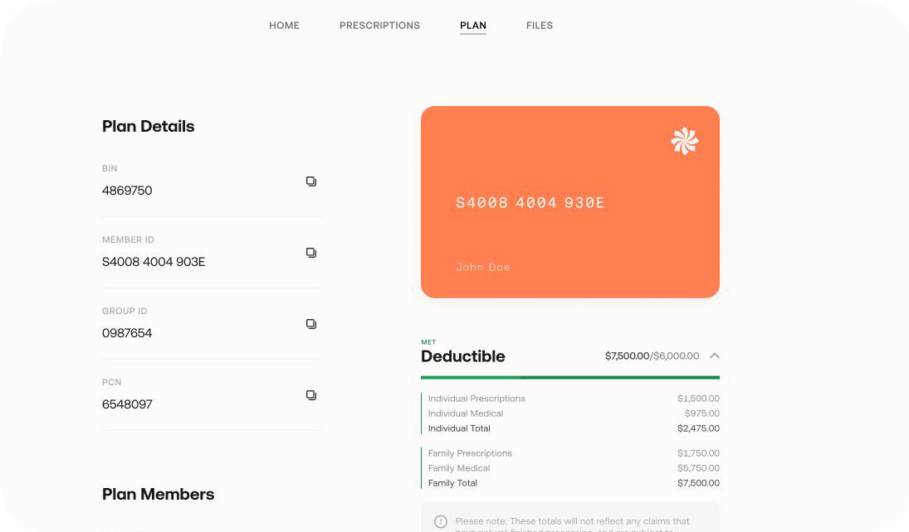

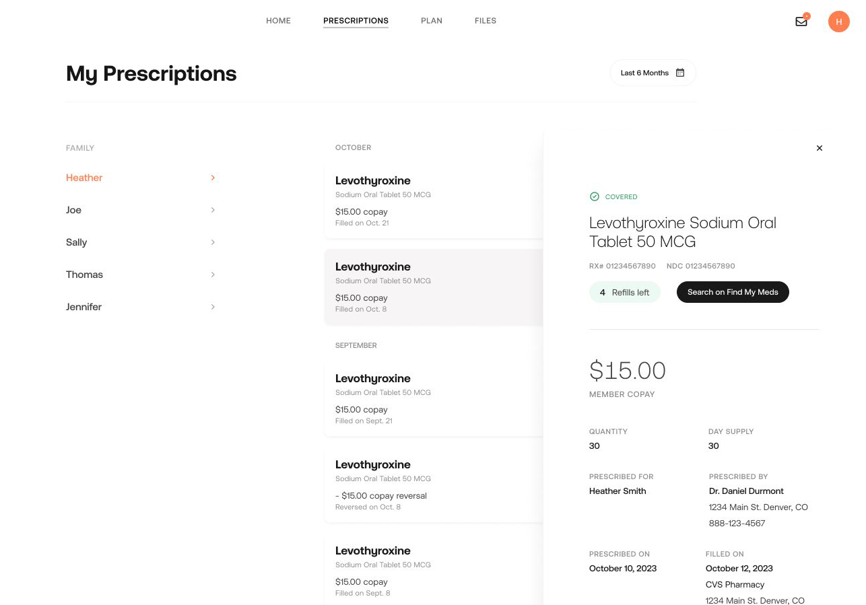
Recommended Resource: Member Portal
Discover easy Rx benefits management in the Member Portal: smithrx.com/portal
Member ID Card
View Claims, PA status
Access your Member ID Card and forms
View prescription claims. Get Prior Authorization Status Notifications
Plan Usage Tracker
Find My Meds
Track total spends against your plan deductible and out-of-pocket limits and the total spend breakdown
Search for the lowest cost pharmacy near you with the Find My Meds tool

Slide 23
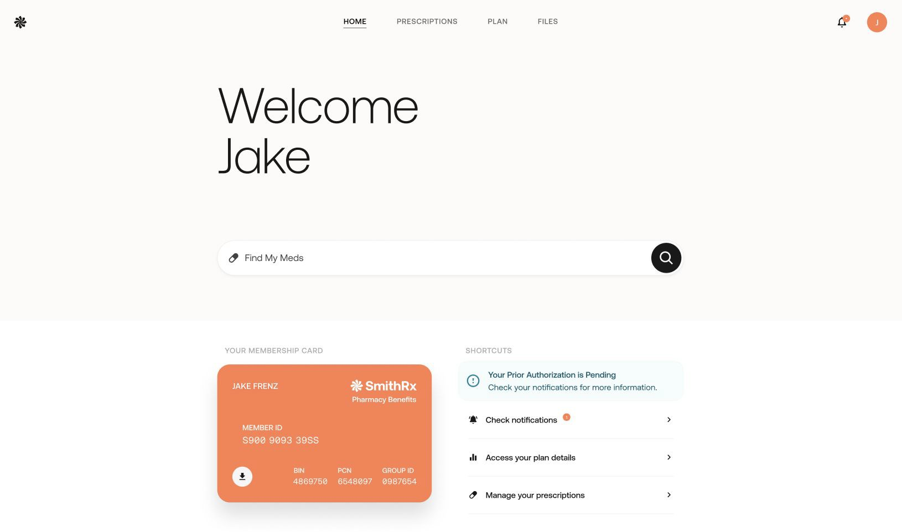
smithrx.com

Slide 24
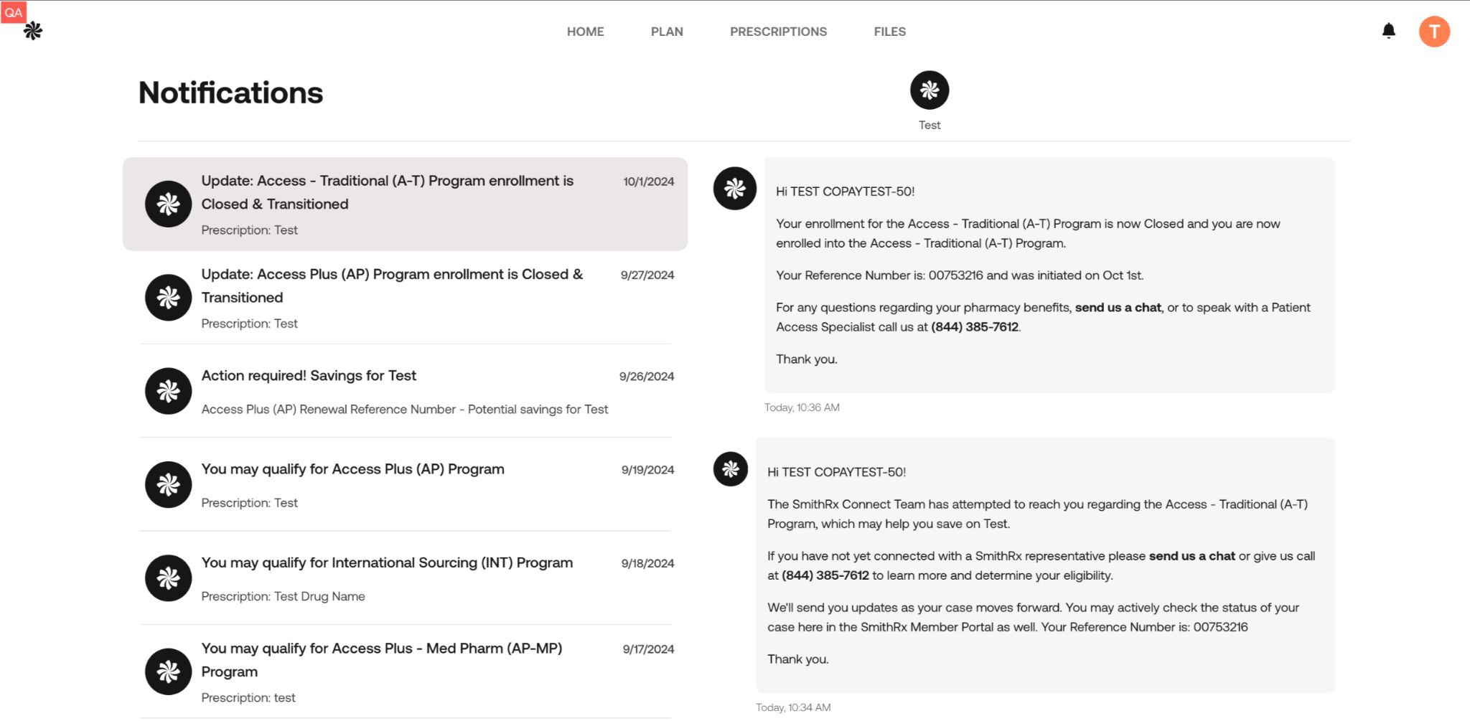
smithrx.com

Slide 25









Our Nationwide Pharmacy Network
65,000 retail locations and growing
Retail Network
Mail Network
Specialty Pharmacy

Slide 26
Connect 3 6 0 : Opportunities for more Rx savings
1
If youʼre taking a qualifying drug, you may hear from SmithRx about additional cost savings programs
2
The SmithRx representative will help you navigate the savings program enrollment
How our cost savings program works to get help you achieve $0 copay
3
Ensure your HR team has your contact information on file so we can reach you and guide you through the easy cost-savings process

Slide 27




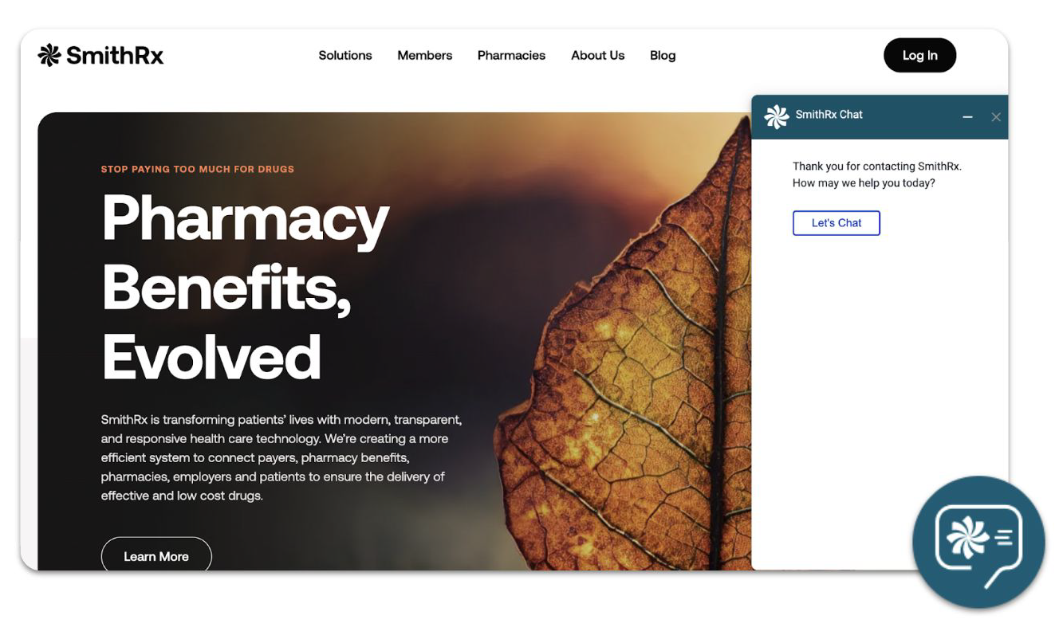

SmithRx Member Services
We make it easy and convenient for you to access your medications and Rx benefits.
Live Chat
Just click the chat icon on the bottom-right of the web page to start.
Member Portal
Create an account on our Member Portal at smithrx.com/portal.
Access answers to FAQs.
Phone - (844) 454-5201
Member Specialists are available:
Mon-Fri 6am - 7pm MT
Sat - 9 am - 2pm MT
Email
help@smithrx.com

Slide 28

CONNECT 360
Cost Savings Programs Adapted to Market Needs
Access Plus Access Specialty Access Traditional | Autoimmune (Humira biosimilars) Cost Plus Drugs Low-Cost Insulin Diabetes Non-Insulin | Multiple Sclerosis GLP1 Referral Network (340) Medical Pharmacy
Pre-2023 | 2023 | 2024
New Programs Diabetes
Weight Loss
Program Expansions
Autoimmune Referral Partners
2025

Slide 29
Connect 360: Opportunities for Rx Savings
What are the Connect 360 Programs?
Access (CA-S & CA-T) Capture manufacturer coupon savings on traditional and specialty medications. Members have a low or $0 copay on prescriptions while also helping employers save on pharmacy benefit costs.
Access Plus: Leverages advocacy foundations and grant programs to reduce cost when a high-cost specialty medication is not covered under the pharmacy benefit. We assist members in navigating and applying to these different programs.
Autoimmune: Through this program, SmithRx members can now access low cost, FDA-approved biosimilars such as Yusimry, a biosimilar for Humira, and Otulfi, a biosimilar for Stelara, through Cost Plus Drugs and Costco Specialty Pharmacy. FDA-approved biosimilars have no clinically meaningful differences in terms of safety and effectiveness from their brand-name counterparts, while offering a more affordable option for members with autoimmune conditions.
Low-Cost Insulin (LCI): This program helps reduce insulin costs at the pharmacy by transitioning to generic and biosimilar insulin products.
Diabetes Non-Insulin (DNI) : Through our partnership with Cost Plus Drugs, we are offering Brenzavvy, an SGLT2 inhibitor, as the lowest cost option for members with type 2 diabetes.
Cost Plus Drugs : Cost Plus Drugs is building an innovative pharmacy model that delivers medications at cost, plus a straightforward 15% markup, along with a $5 dispensing fee and shipping. Cost Plus Drugs carries over 1,000 medications and is continuing to expand their drug list weekly.
Multiple Sclerosis (MS) (at Cost Plus Drugs) The lowest-cost Multiple Sclerosis products on the market through Cost Plus Drugs. Generics offer substantial upfront savings.
Referral Partner Program (340B) Provides members with lower net costs for eligible program medications. By providing access to discounted medications, the 340B program helps eligible healthcare organizations stretch their resources further, enhance patient care, and improve health outcomes.
14

Slide 30
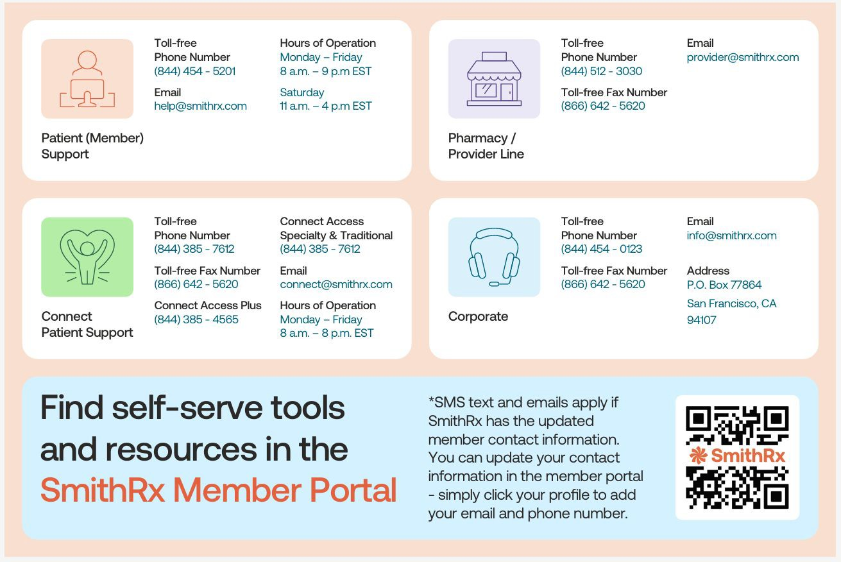
smithrx.com | 2025

Slide 31

Delta Dental of AZ

Slide 32
2026-27 Plan Changes
No Plan, Benefit or Premium Changes
 | Total Monthly Premium | Monthly City Contribution | Monthly Employee Contribution
$2,000 Base Plan (Dependents to Age 19)
EE - Single | $40.96 | $40.96 | $0.00
EE + Spouse | $78.86 | $60.21 | $18.65
EE + Child(ren) | $88.27 | $64.69 | $23.58
EE + Family | $130.16 | $86.44 | $43.72
$4,000 Buy-Up Plan (Dependents to Age 26)
EE - Single | $42.41 | $41.03 | $1.38
EE + Spouse | $81.80 | $60.30 | $21.50
EE + Child(ren) | $96.07 | $65.08 | $30.99
EE + Family | $141.80 | $87.02 | $54.78
Please Note: If you elect the Basic Plan and you have a dependent who will reach Age 19 during the 2025-26 plan year, that is NOT considered a qualifying event and you will not be able to elect the Buy-Up Plan mid-year.

Slide 33

VSP Vision Plan

Slide 34
2026-27 Vision Plan Changes
No Plan or Benefit Changes
Nominal Premium Increase
 | Total Monthly Premium | Monthly City Contribution | Monthly Employee Contribution
Base Plan (Dependents to Age 19)
EE – Single | $9.00 | $0.00 | $9.00
EE + Spouse | $20.24 | $0.00 | $20.24
EE + Child(ren) | $17.81 | $0.00 | $17.81
EE + Family | $28.91 | $0.00 | $28.91
Buy-Up Plan (Dependents to Age 26)
EE - Single | $13.29 | $0.00 | $13.29
EE + Spouse | $29.99 | $0.00 | $29.99
EE + Child(ren) | $27.78 | $0.00 | $27.78
EE + Family | $45.25 | $0.00 | $45.25
Please Note: If you elect the Basic Plan and you have a dependent who will reach Age 19 during the 2025-26 plan year, that is NOT considered a qualifying event and you will not be able to elect the Buy-Up Plan mid-year.

Slide 35

Employee Assistance Program (EAP)

Slide 36
SupportLinc
6 Free Visits per “Issue” per Year
Family Assist
Legal Assist
Safe Ride
Website: www.supportlinc.com
User Name – azmt

Slide 37

Life Insurance

Slide 38

2026-27 Life Insurance Changes
One-Time Open Enrollment Opportunity
$10,000 increase in Supplemental Life with no Medical Questions
Resulting Amount of Supplemental Insurance Can’t Exceed $300,000
Update your Beneficiary
Please contact HR with questions!

Slide 39
VOLUNTARY BENEFITS

Slide 40
GALLAGHER MARKETPLACE
Access to Gallagher Marketplace
Additional/Optional Discounted Benefits
Home and Auto Insurance
Boat, RV or Renters Insurance
Pet Insurance
And more…
Enroll Anytime
Simple Enrollment Process with Payment Options
Easily Compare Rates from Multiple Carriers

Slide 41
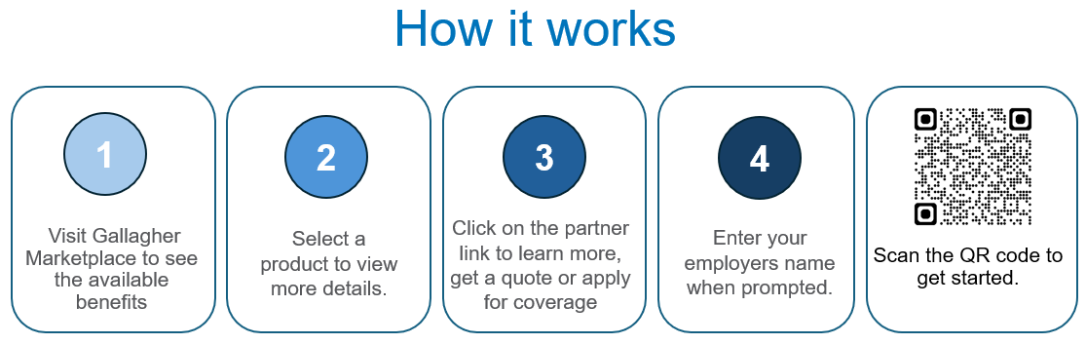
GALLAGHER MARKETPLACE
All programs are portable so you can keep the coverage no matter where life takes you.
Visit Gallagher Marketplace to get started.
When prompted to enter your employer’s name, please use AzMT.

Slide 42

VOLUNTARY BENEFITS
Group Accident Plan
The Group Accident Plan is available through Securian and provides coverage for covered injuries and services.
Post-Tax Deduction
Incident | Payout
Emergency Room | $250
Ambulance Benefit (Ground/Air) | $400/$1,500
Hospital Admission (General/ICU) | $1,000/$2,000
Daily Hospital Confinement | Up to $200/day
Intensive Care Unit | Up to $400/day
Follow Up Treatment by Physician | $100 (Up to 6 Visits)
Urgent Care Treatment | $200
Physical Therapy | $150 Per Visit (Up to 30 Days)
Fracture/Dislocation | Up to $9,000/ Up to $6,000
Wellness | $50 Per Insured Per Calendar Year
 | EE Only | EE + Spouse | EE + Child | EE + Family
Cost Per Month | $9.14 | $14.97 | $20.29 | $29.08
Wellness | $50 | $100 | $100 + | $150 +
Net Cost Monthly | $4.98 | $6.64 | $11.96 | $16.58

Slide 43

How Your Accident Plan Works With Your Medical Insurance
Injury Example
X-ray
$125
Emergency Room $250
Broken Wrist (surgical repair)
$1,500
Physical Therapy
$150 per visit up to 30
Broken Tibia
$3,000
Follow Up Care
$100 per visit up to 6
$9,975
Total Benefit Paid in Cash!
Medical Plan | Deductible / Out of Pocket Maximum | Insurance Claim Expense | Accident Claim Amount | Out of Pocket Expense
PPO | $750 individual ($3,500 Out of Packet Max) | $20,000 | $9,975 | $0 with $6,475 for other expenses
HDHP | $3,300 individual and Out of Pocket Max | $20,000 | $9,975 | $0 with $6,675 for other expenses
This is not intended to show the exact pay out on every broken leg. Payouts may be higher or lower depending on your situation. Please refer to your actual policy.

Slide 44
Group Critical Illness Plan
The Group Critical Illness Plan is available through Securian. This plan provides coverage in a lump-sum benefit if you are diagnosed with an illness below, amongst others. You can choose a benefit between $10k, $20k, and $30k. Your spouse can elect 100% of your coverage and children are eligible for 50%.
Incident | Payout
Heart Attack | 100%
Stroke | 100%
Invasive Cancer | 100%
Non-Invasive Cancer (Carcinoma In Situ) | 25%
Major Organ Failure | 100%
ALS | 100%
Alzheimer’s Disease | 100%
Benign Brain Tumor | 100%
MS | 100%
Parkinson’s Disease | 100%
Coronary Artery Bypass | 25%
End Stage Renal Failure | 100%
Wellness | $50 Per Calendar Year
Recurrence (1 Month Separation) | Up to 100%
Rates will vary based on age and amount of coverage elected.

Slide 45

How Your Critical Illness Plan Works With Your Medical Plan
Example $20,000 Policy
Cancer Diagnosis
$20,000
Medical Plan | Deductible / Out of Pocket Maximum | Insurance Claim Expense | Illness Claim Amount | Out of Pocket Expense
PPO | $750 individual ($3,500 Out of Packet Max) | $50,000 | $20,000 | $0 with $16,500 for other expenses
HDHP | $3,300 individual and Out of Pocket Max ($4,000 Out of Packet Max) | $50,000 | $20,000 | $0 with $16,700 for other expenses
This is not intended to show the exact pay out on every cancer diagnosis. Payouts may be higher or lower depending on your situation. Please refer to your actual policy.

Slide 46
Group Hospital Plan
Securian Hospital Indemnity provides coverage if you are treated for an illness or injury. Pre-existing conditions are waived for all enrollees.
Incident | Payout
Hospitalization | $1,000 ($2,000 If ICU)
Daily Hospitalization / ICU Confinement | $200 per day (up to 30 days) / $400 ICU per day (up to 10 days)
Newborn Care Admission | $200 (up to 3 days)
Inpatient Mental Health Disorder Stay | $200 (up to 30 days)
Inpatient Substance Abuse Disorder Stay | $200 (up to 30 days)
Outpatient Mental Health and Substance Abuse Disorder Diagnostic Screening | $200 (up to 1 per year)
Wellness | $50 Per Insured Per Year
Notes:
Check with Bryce

Slide 47

Group Hospital Plan
Example 2-day maternity stay
Hospital Admission
$1,000
 | EE Only | EE + Spouse | EE + Child | EE + Family
Cost Per Month | $20.04 | $44.12 | $31.17 | $57.84
Wellness | $50 | $100 | $100 + | $150 +
Net Cost Monthly | $15.88 | $35.79 | $22.84 | $45.34
New Born Benefit
$200
Daily Benefit
$200
$1,800
Total Benefit Paid in Cash!
Notes:
Check with Bryce

Slide 48
How to Enroll in Voluntary Benefits
To enroll in these benefits visit the employee navigator site using the following instructions:
Link: https://www.employeenavigator.com/benefits/Account/Register
Enter your:
First Name
Last Name
AZMT Company Identifier: AZTRUST
PIN (Last 4 digits of your SSN)
Date of Birth (mm/dd/yyyy)

Slide 49

Wellness Program

Slide 50
AzMT L.I.V.E.
Early Detection Through Preventive Screenings
Preventive and early detection screenings are brought onsite to provide members a convenient and timely way to protect their health. Preventive screenings and services brought onsite through the AzMT Wellness Program are covered at 100% for eligible AzMT medical plan members. On-site events include, but not limited to, the following:
Health Risk Assessment
Skin Cancer Screenings
Cardiac and Organ Screenings
Mammograms
* Preventive screenings and services are subject to change. Watch for emails and flyers with more details.

Slide 51
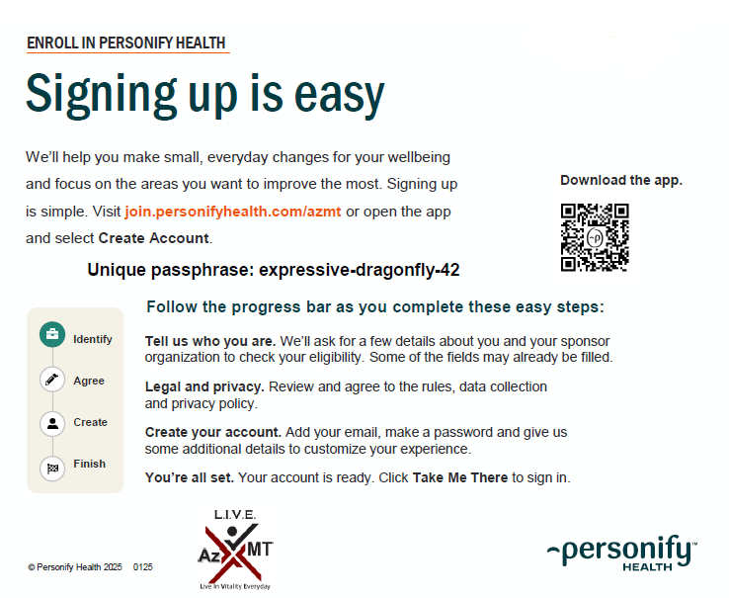
Personify Health
Personify Health
Personify Health is a wellness portal designed to help you track your healthy habits, create new ones, learn about health topics that are important to you, and much more! By engaging in the portal, you earn points that can be redeemed for big rewards.
Health Coaching
Healthy Habit Tracking
Daily Cards
Health Guides
Health Journeys
Personal challenges
Team Challenges
REWARDS!

Slide 52
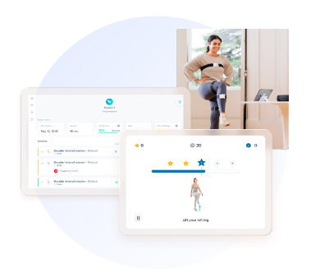
Digital Physical Therapy
Sword Health
Digital Physical Therapy
Movement is medicine. Sword uses sensor technology to deliver a physical therapy program that can be done anywhere, anytime. All the movement data is then shared with your paired physical therapist, who adapts the program based on actual performance.
Bloom
Bloom is a new, digital pelvic-therapy solution that can help women who have suffered from urinary leaking, bowel disorders, pelvic pain, and more. Bloom can be for women in all stages of life including pregnancy, postpartum and menopause.

Slide 53
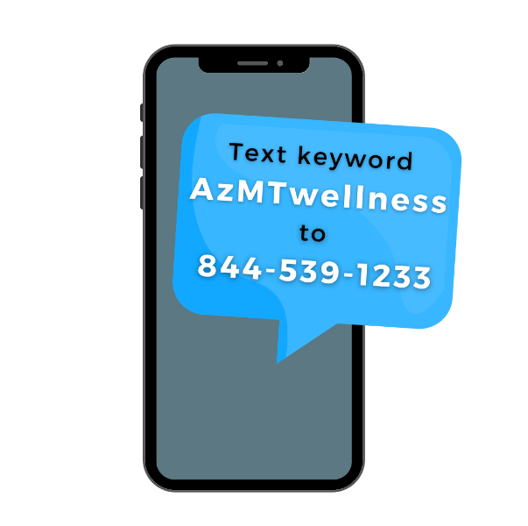

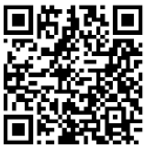
Stay Informed
Monthly Wellness Newsletter
Each month AzMT offers a free digital wellness newsletter that includes health information and upcoming events in the L.I.V.E. wellness program.
Opt-in to the newsletter by scanning the QR code.
Members can sign up with the email of their choice.
Text Message Notifications
Text messages are sent out as reminders for upcoming on-site screenings and services. Text AzMTwellness to 844-539-1233 to opt in!

Slide 54
What’s Next
EVERY employee must re-enroll for benefits for the 2026-27 plan year
Failure to enroll will result in no benefits effective July 01, 2026
Summary Plan Documents (SPDs) will be mailed
New ID Cards
ENROLLMENT MUST BE COMPLETED BY 5:00PM ON APRIL 30, 2026

Slide 55
Questions?
Contact Human Resources, or
Jaime Schulenberg, AzMT’s Pool Administrator, at:
Jaime_Schulenberg@ajg.com
928.391.2297
Or any of the vendors who provide services to the Plan(s)!
Vendor contact information can be found in the OE Benefit Guide

