Slide 1
WICKENBURG 2025-26 OPEN ENROLLMENT

Slide 2
2025-26 Open Enrollment
Benefits Effective July 01, 2025
Open Enrollment
April 16 through May 05, 2025
Add, change or delete current elections (including changing plans, adding or dropping dependents, etc.)
Annual election unless Qualified Family Status change during plan year
Changes to eligibility must be made within 31 days of the event; if not, must wait until the next annual open enrollment period

Slide 3
2025-26 Benefit Changes
Medical/Rx
Increase In-Network HDHP Deductible and Maximum Out-of-Pocket from $3,200/$6,400 to $3,300/$6,600
Add expanded preventive medications to HDHP
Add 3D coverage for mammograms from all in-network providers/facilities
Wellness
Add Personify Health Coaching
Supplemental Life Insurance
One-Time OE Opportunity
FSA/HSA Administrator - Inspira
Marketplace
Voluntary Benefits
Notes:
PPIs: Available OTC – Nexium, Prilosec, Etc.
Nasal: Available OTC -

Slide 4
Domestic Partner Coverage
If you wish to cover a domestic partner effective July 01, 2025, you must file a Declaration of Domestic Partnership available from Human Resources.
The Declaration requires you to attest to the following:
Reside together in an exclusive mutual commitment similar to marriage and have done so for at least the last consecutive 12 months and plan to continue the relationship indefinitely
Not married to each other or any other individual (statutory or commn law) and not a member of another domestic partnership
Both at least 18 years of age
Not related by blood or a degree of closeness which would prohibit marriage under the laws of the State of AZ

Slide 5
Domestic Partner Coverage (continued)
Each are the other’s sole domestic partner and responsible for the other’s common welfare
Jointly responsible for basic living expenses
Both mentally competent to consent to contract when the domestic partnership began and remain so for purposes of contracting for domestic partnership health insurance coverage or the dependent life benefit
Both financially interdependent, jointly responsible for the other’s basic living expenses and able to provide documents providing at least three of the following situations to demonstrate such interdependent has existed for a minimum of the last 12 consecutive months
Joint mortgage, property tax or joint tenancy on a residential lease
Joint bank, investment or credit account
Joint liabilities (e.g., credit cards, car loans)
Joint ownership of real property
Will which designates the other as the primary beneficiary or a beneficiary designation form currently in effect for a retirement plan or life insurance policy
Power of attorney
Written agreement or contract regaring your relationship showing mutual support obligations

Slide 6
Domestic Partner Coverage (continued)
You must agree to notify Arizona Metropolitan Trust (via HR) of any change to your domestic partnership and any eligible children
This form must be signed by both partners, notarized and provided to HR
Tax Acknowledgement Form
Benefits provided to domestic partners and their eligible children are treated as taxable income
Signed by both partners

Slide 7
Quick Plan Review
Town of Wickenburg offers 3 Medical/Rx plans for you to choose from!
High Deductible Health Plan (HDHP)
$3,300/$6,600 Deductible/Max Out-of-Pocket (In-Network)
Includes Prescriptions
Once Deductible Met – Eligible Expenses Paid at 100%
Preventive Care Provided With No Member Cost Share
You MUST elect the HDHP to be eligible for the Health Savings Account (HSA)

Slide 8
Quick Plan Review (continued)
Preferred Provider Option (PPO)
$750/$1,500 Deductible (In-Network)
$3,500/$7,000 Maximum Out-of-Pocket (In-Network)
Excludes Prescriptions – Separate Maximum of $3,600/$7,200
Office Visit Co-Pays
$25 Primary Care Providers
$45 Specialist
Coinsurance
20%
Preventive Care Provided With No Member Cost Share

Slide 9
Quick Plan Review (continued)
Preferred Provider Option Buy-Up (PPO Buy-Up)
$250/$500 Deductible (In-Network)
$3,000/$6,000 Maximum Out-of-Pocket (In-Network)
Excludes Prescriptions – Separate Maximum of $4,100/$8,200
Office Visit Co-Pays
$25 Primary Care Providers
$45 Specialist
Coinsurance
20%
Preventive Care Provided With No Member Cost Share
Refer to the Medical Plan Comparison in the Open Enrollment Guide!

Slide 10
Quick Plan Review (continued)
PPO and PPO Buy-Up – Prescription Co-Pays
 | PPO & PPO Buy-Up | PPO & PPO Buy-Up
 | Network Benefit | Out-of-Network Benefit
Plan Year Out-of-Pocket Maximum
Single | $3,600 / $4,100 | $3,600 / $4,100
Family | $7,200 / $8,200
Retail Pharmacy: 30-Day Supply
Generic Drug (Tier 1) | $15 Copay | Member pays the network pharmacy copay plus the difference between the non-network and network pharmacy amount.
Preferred Drug (Tier 2) | $35 Copay
Non-Preferred Drug (Tier 3) | $55 Copay
Specialty | 20% to Max of $300 | N/A
Retail Pharmacy: 90-Day Supply
Generic Drug (Tier 1) | $30 Copay | Member pays the network pharmacy copay plus the difference between the non-network and network pharmacy amount.
Preferred Drug (Tier 2) | $80 Copay
Non-Preferred Drug (Tier 3) | $130 Copay
Mail Order Pharmacy: 90-Day Supply
Generic Drug (Tier 1) | $30 Copay | N/A
Preferred Drug (Tier 2) | $80 Copay | N/A
Non-Preferred Drug (Tier 3) | $130 Copay | N/A

Slide 11
Health Savings Account (HSA)
New Administrator - Inspira
Only available with enrollment in the HDHP
Maximum Contributions
2025 = $4,300 / $8,550 ($1,000 Catch-Up 55+)
Funds Roll Over Year-to-Year
Ability to Transfer Existing HSA Account

Slide 12
2025-26 Medical/Rx Premiums
For 2025-26 AzMT adopted a nominal 4.5% increase
Employee premiums will experience slight increases for 2025-26

Slide 13
2025-26 Medical/Rx Premiums (continued)
 | 2024-25 Premium | 2025-26 Premium | Employee Cost
HDHP
Employee Only | $577.24 | $603.22 | $2.50
Employee+Spouse | $1,135.46 | $1,186.56 | $177.50
Employee+Child(ren) | $1,044.68 | $1,091.69 | $149.04
Employee+Family | $1,543.86 | $1,613.33 | $305.53
PPO
Employee Only | $629.91 | $658.28 | $0.00
Employee+Spouse | $1,258.15 | $1,314.77 | $196.95
Employee+Child(ren) | $1,158.40 | $1,210.53 | $165.68
Employee+Family | $1,706.81 | $1,783.62 | $337.61
PPO Buy-Up
Employee Only | $644.04 | $673.02 | $14.76
Employee+Spouse | $1,285.37 | $1,343.21 | $225.39
Employee+Child(ren) | $1,185.40 | $1,238.74 | $193.89
Employee+Family | $1,749.44 | $1,828.16 | $382.15

Slide 14
Pre-Certification Reminder
Required for:
Hospital Admissions
Inpatient & Outpatient Surgery
Advanced Imaging
PT, OT & Speech Therapy (Over 20 Visits)
Chemotherapy & Radiation
Home Health
Dialysis, Transplants
Orthotics/Prosthetics over $3k
DME over $3k
Genetic Testing over $1k (Most not covered)
Clinical Trials
Non-Emergent Air Ambulance
Intensive Outpatient Programs
Partial Hospitalizations
Non-Invasive Pre-Natal Testing
Dental Services Required for Medical Procedures
Specialty Infusions/Injectable Medications over $3k/Per

Slide 15
Pre-Certification Reminder (continued)
$300 Penalty for Failure to Pre-Certify
Member Responsibility to Ensure Pre-Cert Done (Prior to Service)
Issues & Proactive Ways to Avoid Them

Slide 16
Case Management
Free service available to all members
Assistance navigating the healthcare system
Assistance for members with critical accidents or complex/chronic illnesses
AmeriBen Medical Management – 855.778.9053

Slide 17
Delta Dental of AZ

Slide 18
2025-26 Dental Plan
No Plan, Benefit or Premium Changes
 | 2024-25 Premium | 2025-26 Premium | Employee Cost
Basic Plan*
Employee Only | $40.96 | $40.96 | $0.00
Employee+Spouse | $78.86 | $78.86 | $11.37
Employee+Child(ren) | $88.27 | $88.27 | $14.19
Employee+Family | $130.16 | $130.16 | $26.76
Buy-Up Plan*
Employee Only | $42.41 | $42.41 | $1.45
Employee+Spouse | $81.80 | $81.80 | $14.31
Employee+Child(ren) | $96.07 | $96.07 | $21.99
Employee+Family | $141.80 | $141.80 | $38.40
*Basic Plan = Dependents to Age 19 / Buy-Up Plan = Dependents to Age 26
Please Note: If you elect the Basic Plan and you have a dependent who will reach Age 19 during the 2025-26 plan year, that is NOT considered a qualifying event and you will not be able to elect the Buy-Up Plan mid-year.

Slide 19
VSP Vision Plan

Slide 20
2025-26 Plan Changes
No Plan or Benefit Changes
Slight Premium Increase
 | 2024-25 Premium | 2025-26 Premium | Employee Cost
Basic Plan*
Employee Only | $7.37 | $7.68 | $7.68
Employee+Spouse | $16.12 | $16.92 | $16.92
Employee+Child(ren) | $14.23 | $14.93 | $14.93
Employee+Family | $22.87 | $24.05 | $24.05
Buy-Up Plan*
Employee Only | $10.58 | $11.04 | $11.04
Employee+Spouse | $23.58 | $24.77 | $24.77
Employee+Child(ren) | $21.86 | $22.95 | $22.95
Employee+Family | $35.46 | $37.31 | $37.31
*Basic Plan = Dependents to Age 19 / Buy-Up Plan = Dependents to Age 26
Please Note: If you elect the Basic Plan and you have a dependent who will reach Age 19 during the 2025-26 plan year, that is NOT considered a qualifying event and you will not be able to elect the Buy-Up Plan mid-year.

Slide 21
Employee Assistance Program (EAP)

Slide 22
SupportLinc
6 Free Visits per “Issue” per Year
Family Assist
Legal Assist
Safe Ride
Website: www.supportlinc.com
User Name – azmt

Slide 23
Telemedicine

Slide 24
Teladoc
Telemedicine (phone or video) 24/7/365
Able to prescribe medications
General Medicine Consultation Fee
$25 Co-Pay PPO and PPO Buy-Up Plans (Applies to Deductible)
$57 Consultation Fee HDHP (Applies to Deductible and Max Out-of-Pocket)$50
Dermatology
Send up to 5 photos of areas of concern
Response within 48 hours
$89 Consultation Fee
Nutritional Coaching
Registered Dieticians
Weight Management, Diabetes, High Blood Pressure, Prenatal Dieting, Etc.
$61 Consultation Fee

Slide 25
Life Insurance

Slide 26
2025-26 Life Insurance Changes
One-Time Open Enrollment Opportunity
$100,000 Supplemental Life with No Medical Questions
Resulting Amount of Insurance Can’t Exceed $300,000
Update your Beneficiary
Please contact HR with questions!

Slide 27
Completing the EOI Process
If you elect coverage that needs EOI, Plansource will automatically direct you to the EOI form for completion.
Answer all health questions, including your height and weight, and ensure that you sign and date the form.
Note: A penned signature is required, electronic signatures will not be accepted.
Return completed forms to Ochs via:
Email: ochs@ochsinc.com (preferred)
Fax: 651-665-3791

Slide 28
How Will Securian Communicate Underwriting Decisions?
For employees:
Medical underwriting decisions and/or requests for additional information will be sent via mail.
For employers:
Medical underwriting decisions will be viewable through the LifeBenefitsExtra portal.

Slide 29
NEW BENEFITS
NEW!

Slide 30
GALLAGHER MARKETPLACE
Access to Gallagher Marketplace
Additional Discounted Benefits
Home and Auto Insurance
Boat, RV or Renters Insurance
Pet Insurance
And more…
Enroll Anytime
Simple Enrollment Process with Payment Options
Easily Compare Rates from Multiple Carriers

Slide 31
GALLAGHER MARKETPLACE
All programs are portable so you can keep the coverage no matter where life takes you
Visit Gallagher Marketplace to get started.
When prompted to enter your employer’s name, please use AzMT.

Slide 32
VOLUNTARY BENEFITS
Group Accident Plan
The Group Accident Plan is available through Securian and provides coverage for covered injuries and services.
Incident | Payout
Emergency Room | $250
Ambulance Benefit (Ground/Air) | $400/$1,500
Hospital Admission (General/ICU) | $1,000/$2,000
Daily Hospital Confinement | Up to $200/day
Intensive Care Unit | Up to $400/day
Follow Up Treatment by Physician | $100 (Up to 6 Visits)
Urgent Care Treatment | $200
Physical Therapy | $150 Per Visit (Up to 30 Days)
Fracture/Dislocation | Up to $9,000/ Up to $6,000
Wellness | $50 Per Insured Per Calendar Year
 | EE Only | EE + Spouse | EE + Child | EE + Family
Cost Per Month | $9.14 | $14.97 | $20.29 | $29.08
Wellness | $50 | $100 | $100 + | $150 +
Net Cost Monthly | $4.98 | $6.64 | $11.96 | $16.58

Slide 33
How Your Accident Plan Works With Your Medical Insurance
Injury Example
X-ray
$125
Emergency Room $250
Broken Wrist (surgical repair)
$1,500
Physical Therapy
$150 per visit up to 30
Broken Tibia
$3,000
Follow Up Care
$100 per visit up to 6
$9,975
Total Benefit Paid in Cash!
Medical Plan | Deductible / Out of Pocket Maximum | Insurance Claim Expense | Accident Claim Amount | Out of Pocket Expense
PPO | $750 individual ($3,500 Out of Packet Max) | $20,000 | $9,975 | $0 with $6,475 for other expenses
HDHP | $3,300 individual and Out of Pocket Max | $20,000 | $9,975 | $0 with $6,675 for other expenses
This is not intended to show the exact pay out on every broken leg. Payouts may be higher or lower depending on your situation. Please refer to your actual policy.

Slide 34
Group Critical Illness Plan
The Group Critical Illness Plan is available through Securian. This plan provides coverage in a lump-sum benefit if you are diagnosed with an illness below, amongst others. You can choose a benefit between $10k, $20k, and $30k. Your spouse can elect 100% of your coverage and children are eligible for 50%.
Incident | Payout
Heart Attack | 100%
Stroke | 100%
Invasive Cancer | 100%
Non-Invasive Cancer (Carcinoma In Situ) | 25%
Major Organ Failure | 100%
ALS | 100%
Alzheimer’s Disease | 100%
Benign Brain Tumor | 100%
MS | 100%
Parkinson’s Disease | 100%
Coronary Artery Bypass | 25%
End Stage Renal Failure | 100%
Wellness | $50 Per Calendar Year
Recurrence (1 Month Separation) | Up to 100%
Rates will vary based on age and amount of coverage elected.

Slide 35
How Your Critical Illness Plan Works With Your Medical Plan
Example $20,000 Policy
Cancer Diagnosis
$20,000
Medical Plan | Deductible / Out of Pocket Maximum | Insurance Claim Expense | Accident Claim Amount | Out of Pocket Expense
PPO | $750 individual ($3,500 Out of Packet Max) | $50,000 | $20,000 | $0 with $16,500 for other expenses
HDHP | $3,300 individual and Out of Pocket Max ($4,000 Out of Packet Max) | $50,000 | $20,000 | $0 with $16,700 for other expenses
This is not intended to show the exact pay out on every cancer diagnosis. Payouts may be higher or lower depending on your situation. Please refer to your actual policy.

Slide 36
Group Hospital Plan
Securian Hospital Indemnity provides coverage if you are treated for an illness or injury. Pre-existing conditions are waived for all enrollees.
Incident | Payout
Hospitalization | $1,000 ($2,000 If ICU)
Daily Hospitalization / ICU Confinement | $200 per day (up to 30 days) / $400 ICU per day (up to 10 days)
Newborn Care Admission | $200 (up to 3 days)
Inpatient Mental Health Disorder Stay | $200 (up to 30 days)
Inpatient Substance Abuse Disorder Stay | $200 (up to 30 days)
Outpatient Mental Health and Substance Abuse Disorder Diagnostic Screening | $200 (up to 1 per year)
Wellness | $50 Per Insured Per Year
Notes:
Check with Bryce

Slide 37
Group Hospital Plan
Example 2-day maternity stay
Hospital Admission
$1,000
 | EE Only | EE + Spouse | EE + Child | EE + Family
Cost Per Month | $20.04 | $44.12 | $31.17 | $57.84
Wellness | $50 | $100 | $100 + | $150 +
Net Cost Monthly | $15.88 | $35.79 | $22.84 | $45.34
New Born Benefit
$200
Daily Benefit
$200
$1,800
Total Benefit Paid in Cash!
Notes:
Check with Bryce

Slide 38
How to Enroll
To enroll in these benefits visit the employee navigator site using the following instructions:
Link: https://www.employeenavigator.com/benefits/Account/Register
Enter your:
First Name
Last Name
AZMT Company Identifier: AZTRUST
PIN (Last 4 digits of your SSN)
Date of Birth (mm/dd/yyyy)

Slide 39
Wellness

Slide 40
AzMT L.I.V.E.
Early Detection Through Preventive Screenings
Preventive and early detection screenings are brought onsite to provide members a convenient and timely way to protect their health. Preventive screenings and services brought onsite through the AzMT Wellness Program are covered at 100% for eligible AzMT medical plan members
* Preventive screenings and services are subject to change. Watch for emails and flyers with more details.
On-site events include, but are not limited to, the following:
Health Risk Assessment
Skin Cancer Screenings
Cardiac and Organ Screenings
Mammograms

Slide 41
Digital Physical Therapy
Sword Health
Thrive
Movement is medicine. Sword uses sensor technology to deliver a physical therapy program that can be done anywhere, anytime. All the movement data is then shared with your paired physical therapist, who adapts the program based on actual performance.
Bloom
Bloom is a new, digital pelvic-therapy solution that can help women who have suffered from urinary leaking, bowel disorders, pelvic pain, and more. Bloom can be for women in all stages of life including pregnancy, postpartum, menopause and postmenopause.

Slide 42
Personify Health
Personify Health is a wellness portal designed to help you track your healthy habits, create new ones, learn about health topics that are important to you, and much more! By engaging in the portal, you earn points that can be redeemed for big rewards.
Healthy Habit Tracking
Daily Cards
Health Guides
Health Journeys
Personal challenges
Team Challenges
REWARDS!

Slide 43
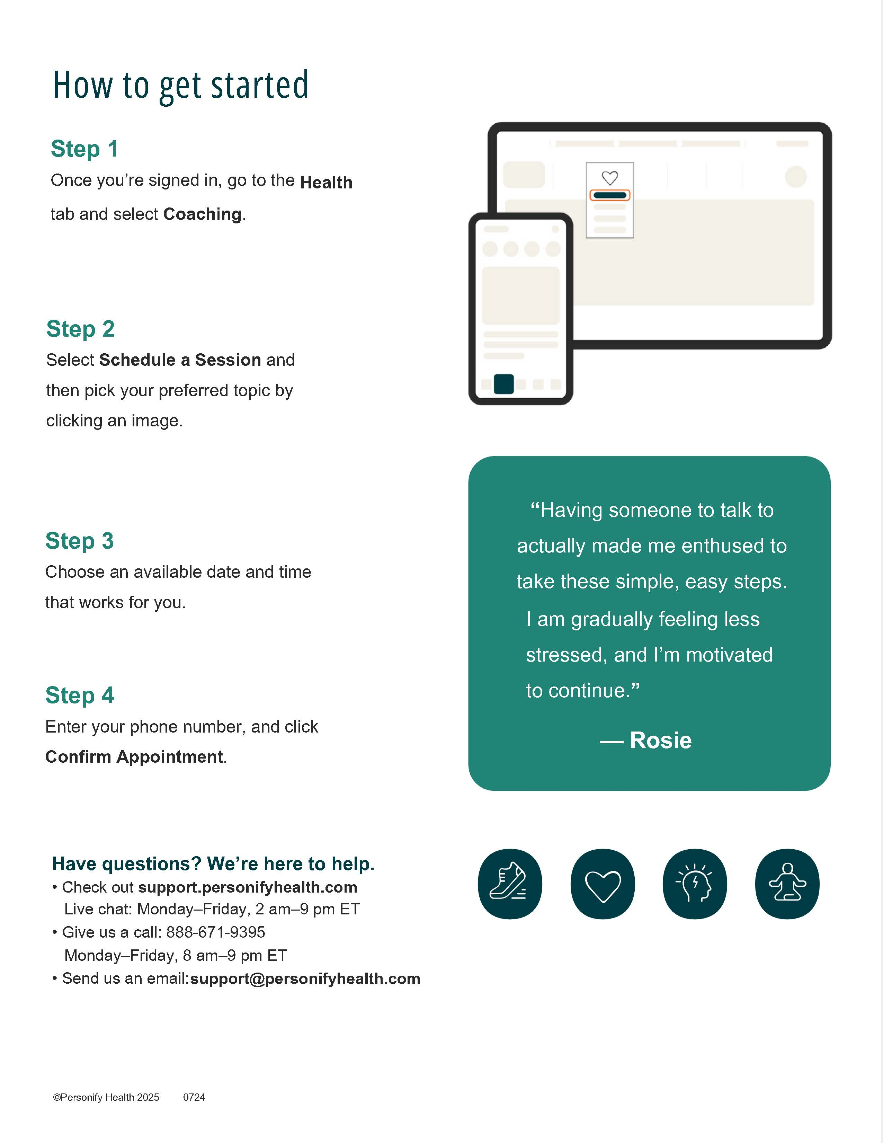
Personify Health – NEW PROGRAM

Slide 44
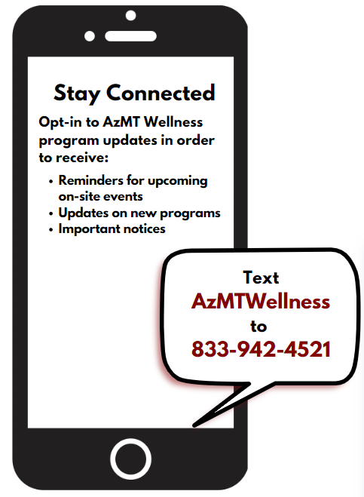
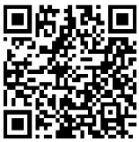
Stay Informed!
Text Message Notifications
Text messages are sent out as reminders for upcoming on-site screenings and services.
Text AzMTwellness to 833-942-4521 to opt in!
Monthly Wellness Newsletter
Each month AzMT offers a free digital wellness newsletter that includes health information and upcoming events in the L.I.V.E. wellness program.
Opt-in to the newsletter by scanning the QR code.
Members can sign up with the email of their choice.

Slide 45
What’s Next
No Action Required UNLESS…
You wish to make changes to current elections
New ID Cards for HDHP
Summary Plan Documents (SPDs) and Summaries of Benefits & Coverage (SBCs) – Will be Mailed
ALL CHANGES NEED TO BE SUBMITTED TO HUMAN RESOURCES BY 5:00PM ON MAY 05, 2025

Slide 46
Questions?

