Slide 1
YOUNGTOWN 2024-25 OPEN ENROLLMENT

Slide 2
2024-25 Open Enrollment
Benefits Effective July 01, 2024
Open Enrollment
May 01, 2024 through May 17, 2024
Add, change or delete current elections (including changing plans, adding or dropping dependents, etc.)
Annual election unless Qualified Family Status change during plan year
Changes to eligibility must be made within 31 days of the event; if not, must wait until the next annual open enrollment period

Slide 3
2024-25 Benefit Changes
Medical/Rx
Increase In-Network HDHP Deductible and Maximum Out-of-Pocket from $3,000/$6,000 to $3,200/$6,400
Wellness
Add Sword Digital Physical Therapy and Bloom Pelvic Health Program
Notes:
PPIs: Available OTC – Nexium, Prilosec, Etc.
Nasal: Available OTC -

Slide 4
Quick Plan Review
Youngtown offers 2 Medical/Rx plans for you to choose from!
High Deductible Health Plan (HDHP)
$3,200/$6,400 Deductible/Max Out-of-Pocket (In-Network)
Includes Prescriptions
Once Deductible Met – Eligible Expenses Paid at 100%
Preventive Care Provided With No Member Cost Share
You MUST elect the HDHP to be eligible for the Health Savings Account (HSA)

Slide 5
Quick Plan Review (continued)
Preferred Provider Option (PPO)
$750/$1,500 Deductible (In-Network)
$3,500/$7,000 Maximum Out-of-Pocket (In-Network)
Excludes Prescriptions – Separate Maximum of $3,600/$7,200
Office Visit Co-Pays
$25 Primary Care Providers
$45 Specialist
Coinsurance
20%
Preventive Care Provided With No Member Cost Share

Slide 6
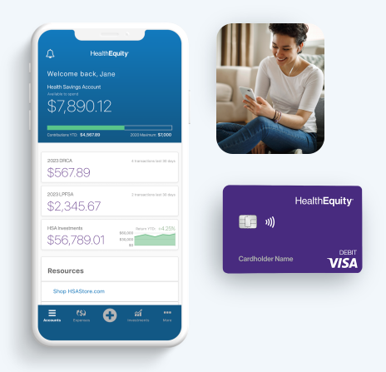
Health Savings Account (HSA)
Only available with enrollment in the HDHP
Maximum Contributions
2024 = $4,150 / $8,300 ($1,000 Catch-Up 55+)
Funds Roll Over Year-to-Year

Slide 7
2024-25 Medical/Rx Premiums
AzMT adopted a nominal increase for 2024-25 – 4%

Slide 8
Delta Dental of AZ

Slide 9
2024-25 Plan Changes
AzMT was able to enhance benefits and still offer a rate pass for 2024-25.
Benefit Changes
Change Bitewing X-Rays from 2x/Year to 1x/Year
Allow 3 Cleanings/Year
Add Special Healthcare Needs Program

Slide 10
VSP Vision Plan

Slide 11
2024-25 Vision Plan Changes
No Benefit Changes
Nominal Premium Increase
Administrative

Slide 12
Employee Assistance Program (EAP)

Slide 13
SupportLinc
6 Free Visits per “Issue” per Year
Family Assist
Legal Assist
Safe Ride
Website: www.supportlinc.com
User Name – azmt

Slide 14
Telemedicine

Slide 15
Teladoc (Via AmeriBen)
Telemedicine (phone or video) 24/7/365
Able to prescribe medications
General Medicine Consultation Fees
$25 – PPO (Applies to Deductible)
$55 – HDHP (Applies to Deductible and Max Out-of-Pocket)
Dermatology
Send up to 5 photos of areas of concern
Response within 48 hours
$85 Consultation Fee
Nutrition Coaching
Registered Dieticians
Weight Management, Diabetes, High Blood Pressure, Prenatal Dieting, Etc.
$59 Consultation Fee

Slide 16
Life Insurance

Slide 17
2024-25 Life Insurance Changes
Annual Open Enrollment Opportunity!
Increase Supplemental Life coverage by $10,000 without Evidence of Insurability (IF you do not currently have coverage or your current coverage is less than $250,000)
Supplemental Life Premiums
Age Rated – Although no premium changes, you may be subject to a rate increased based on your age!
Update your Beneficiary

Slide 18
Wellness Program

Slide 19
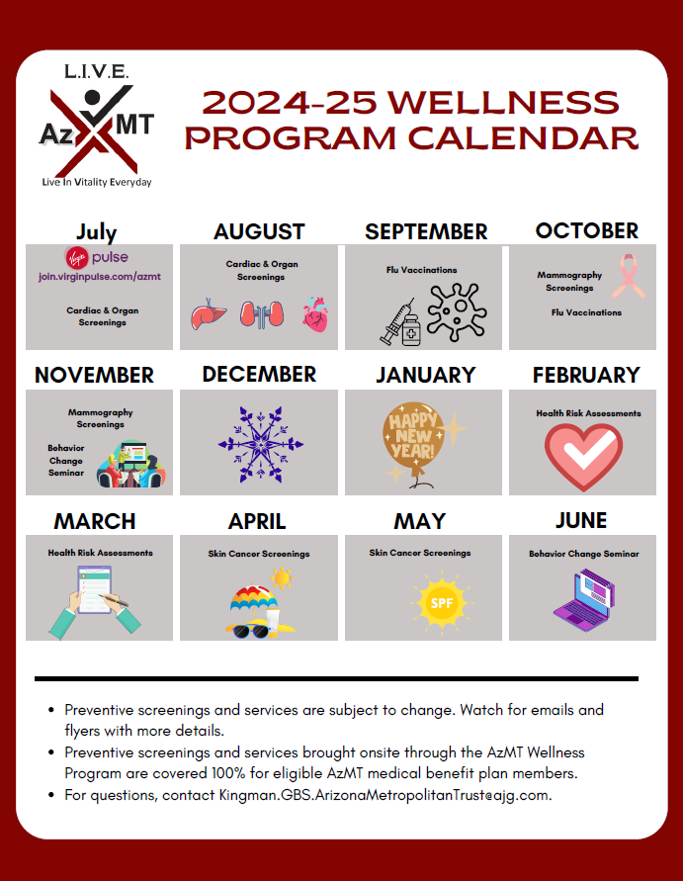
AzMT L.I.V.E.
Early Detection Through Preventive Screenings
Preventive and early detection screenings are brought onsite to provide members a convenient and timely way to protect their health. Preventive screenings and services brought onsite through the AzMT Wellness Program are covered at 100% for eligible AzMT medical plan members. On-site events include, but not limited to, the following:
Health Risk Assessment
Skin Cancer Screenings
Cardiac and Organ Screenings
Mammograms
Flu vaccinations
* Preventive screenings and services are subject to change. Watch for emails and flyers with more details.

Slide 20
Virgin Pulse
Wellness Portal Through Virgin Pulse
Virgin Pulse is a wellness portal designed to help you track your healthy habits, create new ones, learn about health topics that are important to you, and much more! By engaging in the portal, you earn points that can be redeemed for big rewards.
Healthy Habit Tracking
Daily Cards
Health Guides
Health Journeys
Personal challenges
Team Challenges
REWARDS!

Slide 21
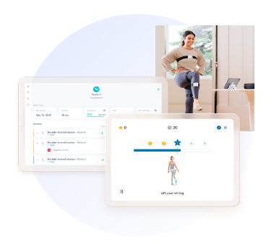
Digital Physical Therapy
Sword Health
Digital Physical Therapy
Movement is medicine. Sword uses sensor technology to deliver a physical therapy program that can be done anywhere, anytime. All the movement data is then shared with your paired physical therapist, who adapts the program based on actual performance.
Bloom
Bloom is a new, digital pelvic-therapy solution that can help women who have suffered from urinary leaking, bowel disorders, pelvic pain, and more. Bloom can be for women in all stages of life including pregnancy, postpartum and menopause.

Slide 22
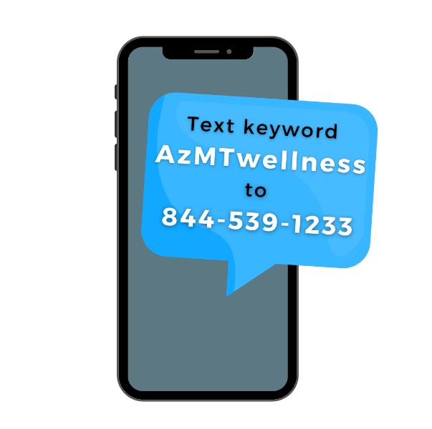
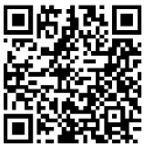
Stay Informed
Monthly Wellness Newsletter
Each month AzMT offers a free digital wellness newsletter that includes health information and upcoming events in the L.I.V.E. wellness program.
Opt-in to the newsletter by scanning the QR code.
Members can sign up with the email of their choice.
Text Message Notifications
Text messages are sent out as reminders for upcoming on-site screenings and services. Text AzMTwellness to 844-539-1233 to opt in!

Slide 23
What’s Next
No New Enrollment Forms UNLESS…
You wish to make changes to current elections
New ID Cards for HDHP (or plan changes)
Revised Summary Plan Documents (SPDs) and Summaries of Benefits & Coverage (SBCs)
Will be Mailed
ENROLLMENT FORMS ARE DUE TO ADMINISTRATION BY 5:00PM ON MAY 17, 2024

Slide 24
Questions?
Check with Administration OR
Jaime Schulenberg, AzMT’s Pool Administrator, at Jaime_Schulenberg@ajg.com or 928.391.2297 OR
Any of the Plan vendors!

