Slide 1
WICKENBURG 2023-24 OPEN ENROLLMENT

Slide 2
2023-24 Open Enrollment
Benefits Effective July 01, 2023
Open Enrollment
April 19 through May 03, 2023
Add, change or delete current elections (including changing plans, adding or dropping dependents, etc.)
Annual election unless Qualified Family Status change during plan year
Changes to eligibility must be made within 31 days of the event; if not, must wait until the next annual open enrollment period

Slide 3
2023-24 Benefit Changes
Increase HDHP Deductible and Maximum Out-of-Pocket from $2,900/$5,800 to $3,000/$6,000
Add Coverage for Updated Preventive Guidelines
Cover COVID Testing In-Network ONLY (Subject to applicable co-pay)
Reduce Teladoc Consultation Fees:
PPO/PPO Buy-Up - $25
HDHP - $55
Add Virgin Pulse to Wellness
Notes:
PPIs: Available OTC – Nexium, Prilosec, Etc.
Nasal: Available OTC -

Slide 4
Quick Plan Review
Town of Wickenburg offers 3 Medical/Rx plans for you to choose from!
High Deductible Health Plan (HDHP)
$3,000/$6,000 Deductible/Max Out-of-Pocket (In-Network)
Includes Prescriptions
Once Deductible Met – Eligible Expenses Paid at 100%
Preventive Care Provided With No Member Cost Share
You MUST elect the HDHP to be eligible for the Health Savings Account (HSA)

Slide 5
Quick Plan Review (continued)
Preferred Provider Option (PPO)
$750/$1,500 Deductible (In-Network)
$3,500/$7,000 Maximum Out-of-Pocket (In-Network)
Excludes Prescriptions – Separate Maximum of $3,600/$7,200
Office Visit Co-Pays
$25 Primary Care Providers
$45 Specialist
Coinsurance
20%
Preventive Care Provided With No Member Cost Share

Slide 6
Quick Plan Review (continued)
Preferred Provider Option Buy-Up (PPO Buy-Up)
$250/$500 Deductible (In-Network)
$3,000/$6,000 Maximum Out-of-Pocket (In-Network)
Excludes Prescriptions – Separate Maximum of $4,100/$8,200
Office Visit Co-Pays
$25 Primary Care Providers
$45 Specialist
Coinsurance
20%
Preventive Care Provided With No Member Cost Share
Refer to the Medical Plan Comparison on Pages 14-16 of the Open Enrollment Guide!

Slide 7
Quick Plan Review (continued)
PPO and PPO Buy-Up – Prescription Co-Pays
 | PPO & PPO Buy-Up | PPO & PPO Buy-Up
 | Network Benefit | Out-of-Network Benefit
Plan Year Out-of-Pocket Maximum
Single | $3,600 / $4,100 | $3,600 / $4,100
Family | $7,200 / $8,200
Retail Pharmacy: 30-Day Supply
Generic Drug (Tier 1) | $15 Copay | Member pays the network pharmacy copay plus the difference between the non-network and network pharmacy amount.
Preferred Drug (Tier 2) | $35 Copay
Non-Preferred Drug (Tier 3) | $55 Copay
Specialty | 20% to Max of $300 | N/A
Retail Pharmacy: 90-Day Supply
Generic Drug (Tier 1) | $30 Copay | Member pays the network pharmacy copay plus the difference between the non-network and network pharmacy amount.
Preferred Drug (Tier 2) | $80 Copay
Non-Preferred Drug (Tier 3) | $130 Copay
Mail Order Pharmacy: 90-Day Supply
Generic Drug (Tier 1) | $30 Copay | N/A
Preferred Drug (Tier 2) | $80 Copay | N/A
Non-Preferred Drug (Tier 3) | $130 Copay | N/A

Slide 8
Health Savings Account (HSA)
Only available with enrollment in the HDHP
Maximum Contributions
2023 = $3,850 / $7,750 ($1,000 Catch-Up 55+)
Funds Roll Over Year-to-Year

Slide 9
2023-24 Medical/Rx Premiums
For 2023-24 AzMT adopted a nominal 3% increase
Employee premiums will experience slight increases for 2023-24

Slide 10
2022-23 Medical/Rx Premiums (continued)
 | 2022-23 Premium | 2023-24 Premium | Employee Cost
HDHP
Employee Only | $538.82 | $555.04 | $2.50
Employee+Spouse | $1,059.88 | $1,091.79 | $163.53
Employee+Child(ren) | $975.15 | $1,004.50 | $137.34
Employee+Family | $1,441.10 | $1,484.48 | $281.33
PPO
Employee Only | $587.98 | $605.68 | $0.00
Employee+Spouse | $1,174.41 | $1,209.76 | $181.22
Employee+Child(ren) | $1,081.30 | $1,113.85 | $152.45
Employee+Family | $1,593.21 | $1,641.17 | $310.65
PPO Buy-Up
Employee Only | $601.17 | $619.27 | $13.59
Employee+Spouse | $1,199.81 | $1,235.93 | $207.39
Employee+Child(ren) | $1,106.50 | $1,139.81 | $178.14
Employee+Family | $1,623.99 | $1,682.15 | $351.63

Slide 11
Delta Dental of AZ

Slide 12
2023-24 Plan Changes
No Benefit or Premium Changes
 | 2022-23 Premium | 2023-24 Premium | Employee Cost
Basic Plan*
Employee Only | $40.96 | $40.96 | $0.00
Employee+Spouse | $78.86 | $78.86 | $11.37
Employee+Child(ren) | $88.27 | $88.27 | $14.19
Employee+Family | $130.16 | $130.16 | $26.76
Buy-Up Plan*
Employee Only | $42.41 | $42.41 | $1.45
Employee+Spouse | $81.80 | $81.80 | $14.31
Employee+Child(ren) | $96.07 | $96.07 | $21.99
Employee+Family | $141.80 | $141.80 | $38.40
*Basic Plan = Dependents to Age 19 / Buy-Up Plan = Dependents to Age 26

Slide 13
VSP Vision Plan

Slide 14
2023-24 Plan Changes
No Benefit Changes
Slight Premium Increase
Administrative Cost
 | 2022-23 Premium | 2023-24 Premium | Employee Cost
Basic Plan*
Employee Only | $7.27 | $7.31 | $7.31
Employee+Spouse | $16.02 | $16.06 | $16.06
Employee+Child(ren) | $14.13 | $14.17 | $14.17
Employee+Family | $22.77 | $22.81 | $22.81
Buy-Up Plan*
Employee Only | $10.45 | $10.51 | $10.51
Employee+Spouse | $23.45 | $23.51 | $23.51
Employee+Child(ren) | $21.73 | $21.79 | $21.79
Employee+Family | $35.33 | $35.39 | $35.39
*Basic Plan = Dependents to Age 19 / Buy-Up Plan = Dependents to Age 26

Slide 15
Employee Assistance Program (EAP)

Slide 16
SupportLinc
6 Free Visits per “Issue” per Year
Family Assist
Legal Assist
Safe Ride
Website: www.supportlinc.com
User Name – azmt

Slide 17
Telemedicine

Slide 18
Teladoc
Telemedicine (phone or video) 24/7/365
Able to prescribe medications
General Medicine Consultation Fee
$25 Co-Pay PPO and PPO Buy-Up Plans (Applies to Deductible)
$55 Consultation Fee HDHP (Applies to Deductible and Max Out-of-Pocket)$50
Dermatology
Send up to 5 photos of areas of concern
Response within 48 hours
$85 Consultation Fee
Nutritional Coaching
Registered Dieticians
Weight Management, Diabetes, High Blood Pressure, Prenatal Dieting, Etc.
$59 Consultation Fee

Slide 19
2023-24 Life Insurance

Slide 20
2023-24 Plan Changes
No Plan or Premium Changes
Update your Beneficiary

Slide 21
2023-24 Wellness

Slide 22
AzMT L.I.V.E.
Still to come 2022-23
Skin Cancer Screenings (May)
Happy Feet MoveSpring Step Challenge (May)
Wellness Seminar (June)
Going away in 2023-24
Omada
Livongo
MoveSpring
New in 2023-24
Virgin Pulse
Comprehensive and interactive program
Engage in healthy behaviors and get rewards and incentives!

Slide 23
2023-2024 Wellness Calendar
Preventive screenings and services are subject to change. Watch for emails and flyers with more details.
Preventive screenings and services brought onsite through the AzMT Wellness Program are covered at 100% for eligible AzMT medical plan members.

Slide 24
Virgin Pulse
Healthy Habit Tracking
Daily Cards
Health Guides
Health Journeys
Personal challenges
Team Challenges
REWARDS!

Slide 25
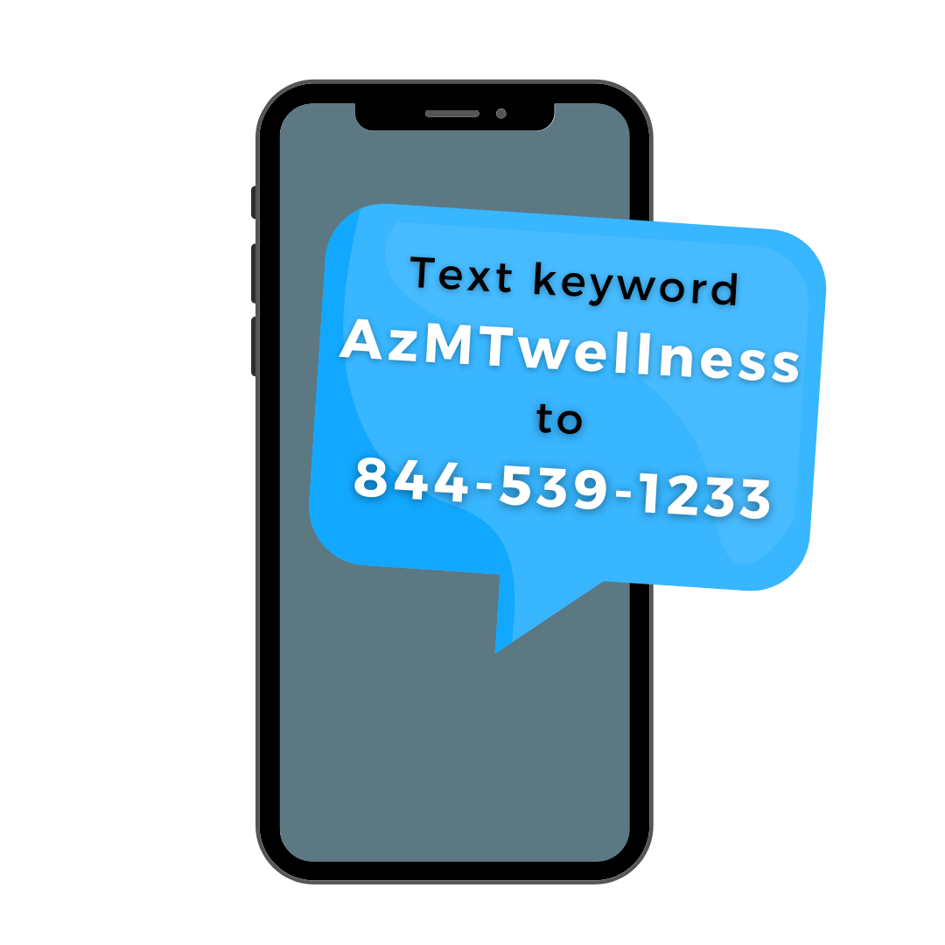
Stay Informed
Opt-in to receive text message notifications!

Slide 26
What’s Next
No Action Required UNLESS…
You wish to make changes to current elections
New ID Cards
Summary Plan Documents (SPDs) and Summaries of Benefits & Coverage (SBCs) – Will be Mailed
ALL CHANGES NEED TO BE SUBMITTED TO HUMAN RESOURCES BY 5:00PM ON MAY 03, 2023

Slide 27
Questions?

